Slide 1

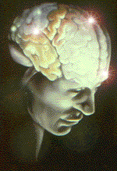
UNDERSTANDING YOUR BRAIN
&
NERVOUS SYSTEM
Ocean Park Natural Therapies
Dr. T. W. Brown, ND

Slide 2
Your Nervous System
Your Nervous System is Composed of 3 Distinct Components
  Central Nervous System
  Peripheral Nervous System
  Autonomic Nervous System

Slide 3
Central Nervous System
Brain Stem & Spine Act
Like a “Central Subway” or Main SkytrainSystem

Slide 4
Central Nervous System
  Trains go back and forth along a central routing system
  When all goes well everything is quick and efficient
  When one area gets in “trouble” the whole system begins to back up
  becoming “dysfunctional”.

Slide 5


Central Nervous System Disrupted

Slide 6
Peripheral Nervous System
Routes connecting to outlying areas “the suburbs” =extremities
Connects to spinal (central) system at connecting terminals or hubs called –
  Nerve plexi or
  Nerve ganglia

Slide 7
Peripheral Nervous System
Hubs
Connect
From Outlying
Areas to
Central Nervous System

Slide 8
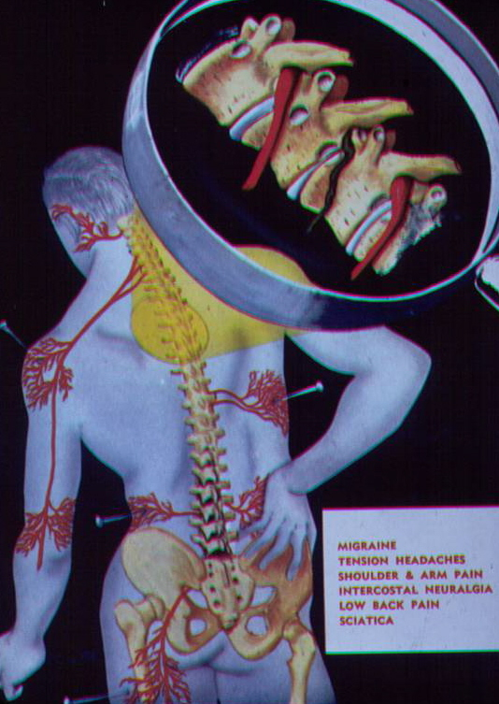
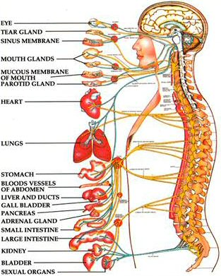
Autonomic Nervous System
Automatic Internal Processing

Slide 9
Autonomic Nervous System
Sympathetic
Parasympathetic
Enteric

Slide 10
Autonomic Nervous System
Sympathetic – fight, flight, fright and the ‘away from system’
Parasympathetic – rest, repair, relaxation, reproduction – our ‘towards system’
Enteric nervous system – our gut or ‘belly brain’ -

Slide 11
Autonomic Nervous System
Innervates everything – including all joints, viscera (guts), and extracellular tissue (outside the cell)
Operates entirely at the subconscious levels of the nervous system (Limbic and Reptilian Levels)

Slide 12
The 4 Levels of Central Nervous System Function
Reptilian – Brain Stem & Spinal Cord
Limbic – Midbrain Functions
Cortical – Lower & Higher Brain Functions

Slide 13
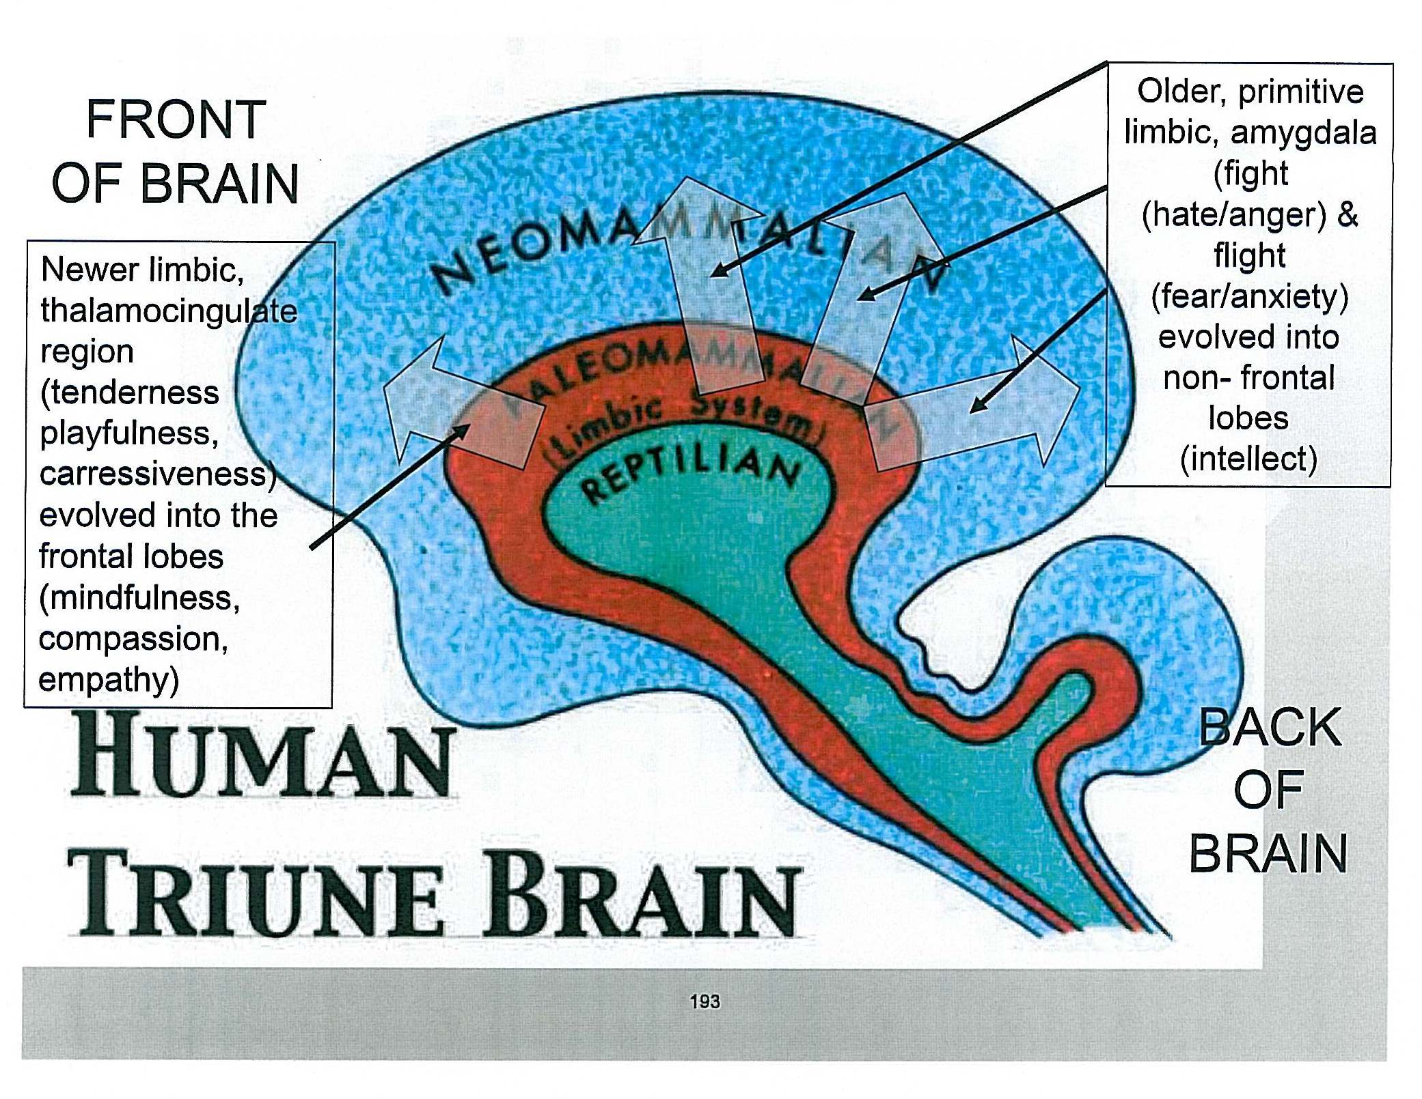
Human Triune Brain

Slide 14
Reptilian System
Primitive High Speed
Basic & Reflexive
Poor Differentiation
Basic Survival Functions
  Withdrawal or Startle Reflexes
  Food – Suckling, Swallowing Reflexes
  Shelter – Bonding, Fetal Positioning
  Reproduction – Mating Reflexes
  Territorial – Proprioception Reflexes

Slide 15
Reptilian System
Reflexive
  Reflexes are designed to activate quickly – ie without thought
  Activate only when stimulated
  Are not supposed to be on – all-the-time or at-the-wrong-time.
  Should be active when needed.
Inappropriate activation/deactivation equals problems in normal processing

Slide 16
Limbic – Mammalian Brain
Midbrain
Emotions
Bonding
Pain – Abandonment-Survival
Affects Decision Making – Towards/Away From

Slide 17
“Survival System Memories”
Memory Can Store in the Reptilian and Parts of the Limbic System
  As opposed to everyday memories…..
  These are remembered and put into long term survival memory – very hard to extinguish…(IMPRINTED) ...
  Their purpose is to “protect” you….
  They form the basis of phobias, neurosis, and post traumatic stress syndromes

Slide 18
Survival System Memories
(Imprints)
Because they reside below the conscious level of brain functioning…
They have to be treated from the level of the subconscious/ unconscious functioning – (much like hidden files/programs in a computer)
… Not from conscious over-ride “programming”

Slide 19
Cortical Functions
Adult
Conscious - Cognitive
Comparative
Preplanning- Initiates
Inhibitor to Reflex System
Higher Energy Usage System
  Shuts down when power goes down

Slide 20
Higher Brain Functioning
Preplanning & Initiation
  The person operating the computer
  Decides direction and desired outcomes
  Cortex is the keyboard – to input and initiate functioning.

Slide 21
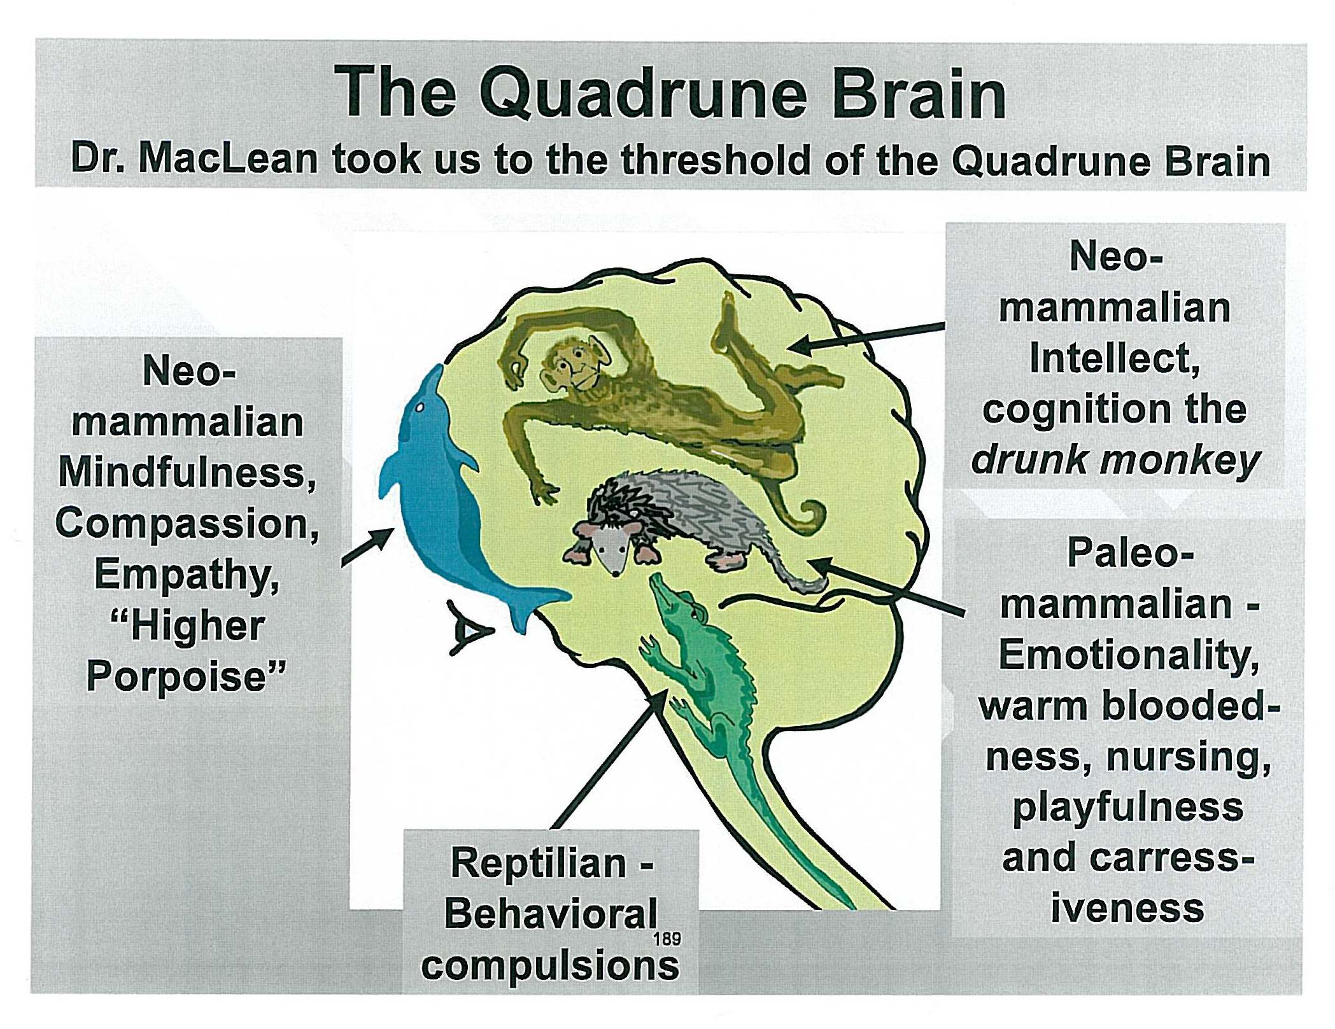
The Quadrune Brain

Slide 22
Higher Brain Functioning
Inhibitory –
  Braking System on Lower Functions
  Loss of higher functioning = exaggerated reflex actions – as with deep tendon reflexes

Slide 23
Higher Brain Functioning
Integration
  Two of almost everything
  Sharing and comparing of information
  When working properly appears to be one co-ordinated , whole brain
  When not working properly seems fragmented, fractured, or broken

Slide 24
Higher Brain Functioning
High Energy Utilization
  Requires blood flow for oxygen, nutrients, and waste removal
Loss of Energy results in:
  Hibernation or Safe Mode
  Shuts down to basic survival functions
  Loss of inhibition – basic behaviors surface or unleash
  Coma or/at least sleep if severe (think of alcohol overload)

Slide 25
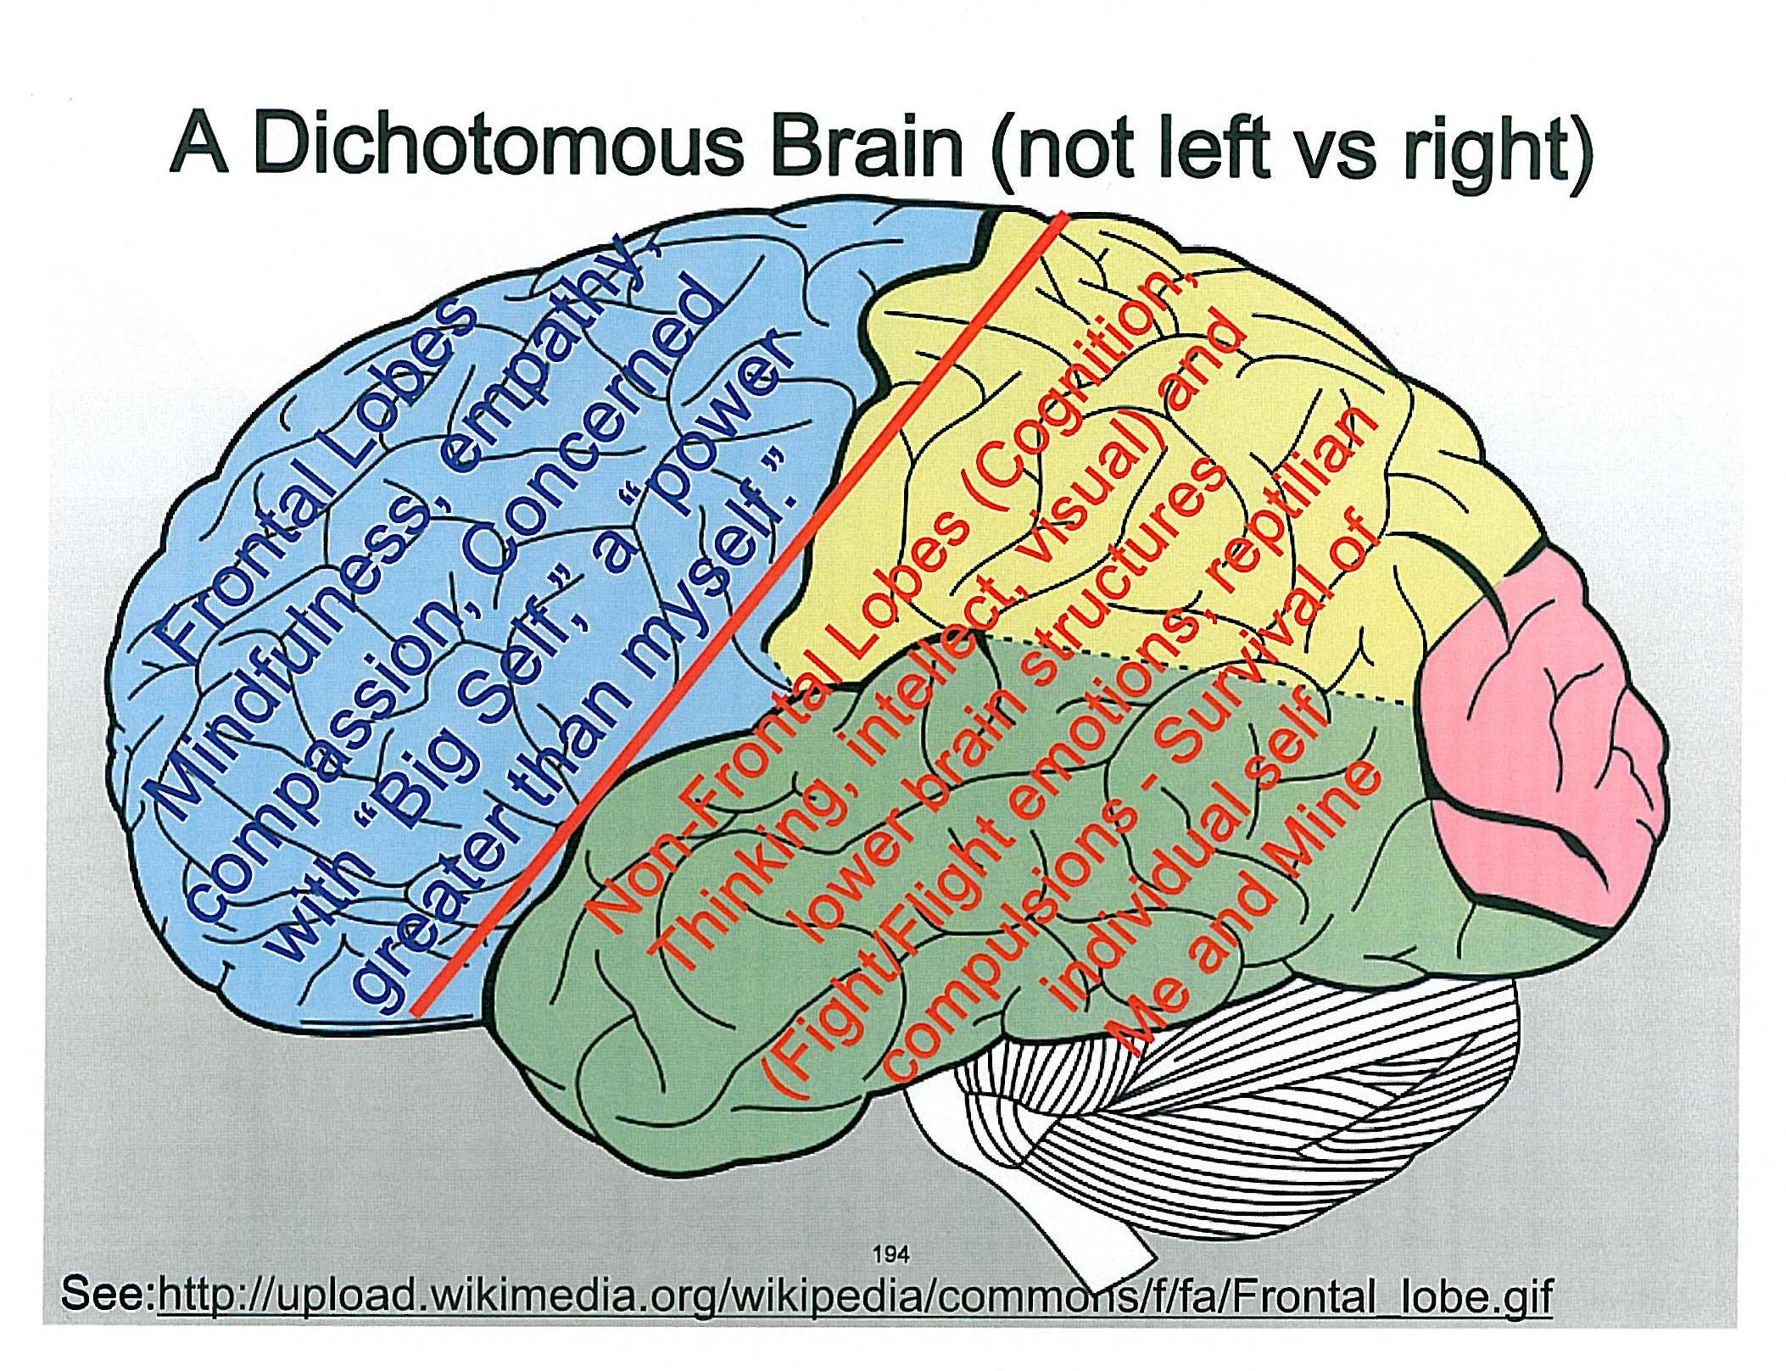
Cortical Function – Front/Back

Slide 26
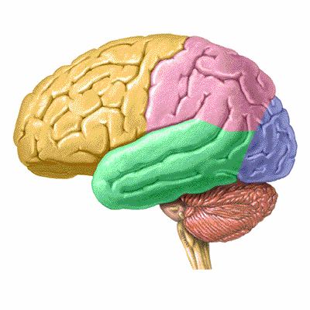
There are 6 Areas of Major Brain Function
PFC – Prefrontal Cortex
ACG – Anterior Cingulate Gyrus
DLS – Deep Limbic System
BG – Basal Ganglia
TL’s - Temporal Lobes
Cerebellum
Generally there are 2 sides to each area

Slide 27
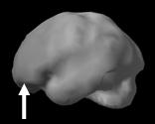
Prefrontal Cortex
PFC
Chief Executive Officer
Adult - Executive functions
  Forethought
  Judgement
  Impulse Control
Not fully developed until adulthood
Associated with ADD, Head Injuries, Toxic Exposure

Slide 28
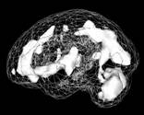
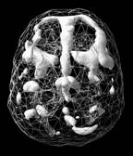
Anterior Cingulate Gyrus
ACG
The Brain’s Gear Shifter
Involved with
  Flexibility – ability to adapt or change
  Cooperation
  Error Detection
Problems of worry, hold grudges, opposition, argumentative
Side View
Top Down View

Slide 29
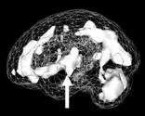
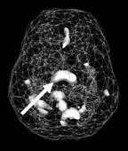
Deep Limbic System
DLS
Sets Brain’s Emotional Tone
Filter through which we interpret and color events according to emotional state of mind
Affects motivation & drive
Associated with depression
Deep Limbic Side View
Deep Limbic Top View

Slide 30
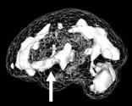
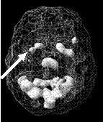
Basal Ganglia
BG
Sets Brain’s Alarm or Anxiety Level
Associated with
  Anxiety
  Irritability
Helped with
  Relaxation Therapies
  Supplementation
  Biofeedback Training
BG Left Side View
BG Top Down View

Slide 31
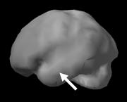
Temporal Lobes
TL’s
The “What” Pathways of the Brain
Involved with
  Language
  Hearing and Reading
  Music and Voice Tone
  Connecting name to object
  Spiritual connections
Temporal Lobe Left Side

Slide 32
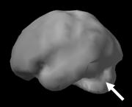
CEREBELLUM
Lieutenant of the Cortex
Motor Control & Feedback
Usually the most active part of the brain
Involved with high speed decision making and reactions
Associated with trauma, toxins, ADD, impulsivity, and judgement issues.
Cerebellum Side View

Slide 33
ASSESSMENTS
Assessments involve Functional Evaluation of the different areas of the brain
Functional Questionnaires
Functional Brain Scans
Functional Neurological Testing
EEG Mapping

Slide 34
SCANS
fMRI or SPECT Scans – to demonstrate blood flow of the brain under different activities
Lack of blood flow = poor brain function
Deposits of iron indicate areas of previous damage/trauma

Slide 35
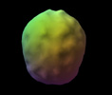
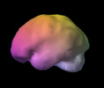
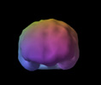
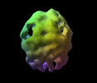
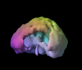
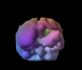
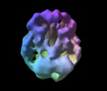
Brain Scans
Normal Brain Top View
Normal Brain Side View
Normal Brain Front View
Alzheimer Brain Views
Trauma Front View
Stroke Side View

Slide 36
QUESTIONNAIRES
Questionnaires have been correlated with brain scans – reliable predictors of function
Correlate 6 areas of brain function for differential diagnosis
3 major questionnaires –
  Brain Master Questionnaire
  ADD/ADHD
  Anxiety/Depression

Slide 37
Questionnaires
Need to be filled out by two people
  Indicate objective (other person)
  Plus subjective (your self) evaluation
These two perspectives gain a more accurate assessment than just one view.
Scoring indicates – minor, probable, highly probable involvement

Slide 38
Neurological Assessments
Standard neurological evaluations for pathology or dysfunction
Non-standard assessments using autonomic reflex testing and manual muscle testing for strength and reflexes.
  Both help to pinpoint problem areas

Slide 39
Neurological Assessments
Designed to Differentiate Injured or Impaired Functions from Healthy Functional Neurons

Slide 40
Interference Factors
The following are common causes of interference to normal healthy brain functioning:
  Injury – Central, Spinal, Peripheral
  Toxicity – Infections, Petrochemical toxins, drugs,
  Deficiencies – Lack of essential nutrients, sleep, etc.

Slide 41
INTEGRATION FACTORS
NUTRIENTS
EXERCISE
TOXINS
STRUCTURAL INTEGRATION
COMMUNICATION SYSTEMS
  OPERATING SYSTEMS
  PROGRAMS
  LINKAGE

Slide 42
Integration Factors
The brain is dependent on the body for its functioning
  Needs oxygen ….
  Needs blood supply for food and waste removal….
  Has little room for toxin storage….
  Has little capacity for structural rearrangements….

Slide 43
Integration Factors
Therefore the brain can malfunction – “Feel like it is broken…”
when it is affected by
Structural disruption….CNS, Peripheral, or Locally
Nutritional deficiencies…. Vitamin, Minerals, Enzymes
Toxicity ….Infections, Drugs, Chemicals
or Disrupted communication systems

Slide 44
BACK PAIN
Deep Limbic System - Thalamus
Irritability/Stress

Slide 45

Fixing Broken Brains
Involves
Identifying and Correcting all the factors that are causing interference
In the proper sequence
Thoroughly
Prozac ®
Paxil ®
Zoloft ®

Slide 46
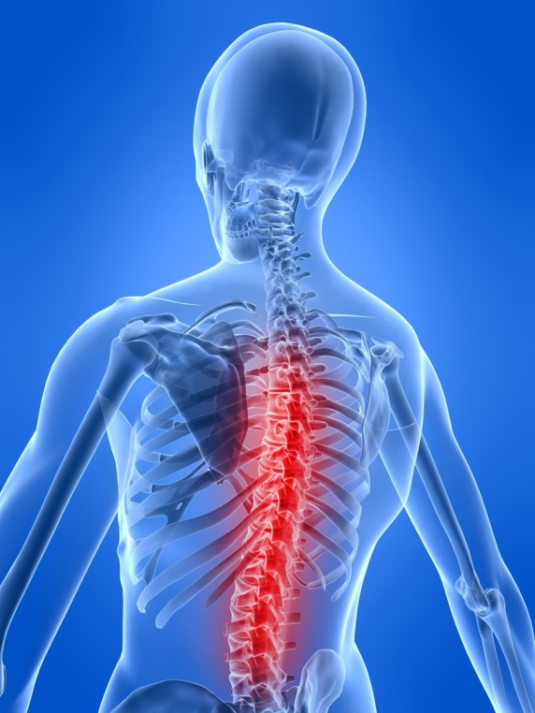
Fixing Broken Brains
Means tuning the system
With Structural Integration, Nutrients, Reprogramming, and Integrated Therapies
To create
Healthy Integrated Functioning

Slide 47
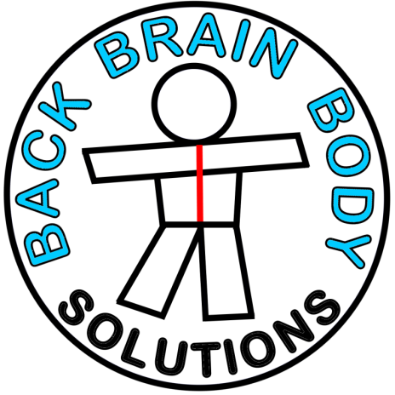
Healthy Brain Solutions
Ocean Park Natural Therapies
#200 12761-16th Avenue
Surrey, B.C.
604-538-3017

