Slide 1
Autonomic Response Testing
Your Internal Sensing System’s Response

Slide 2
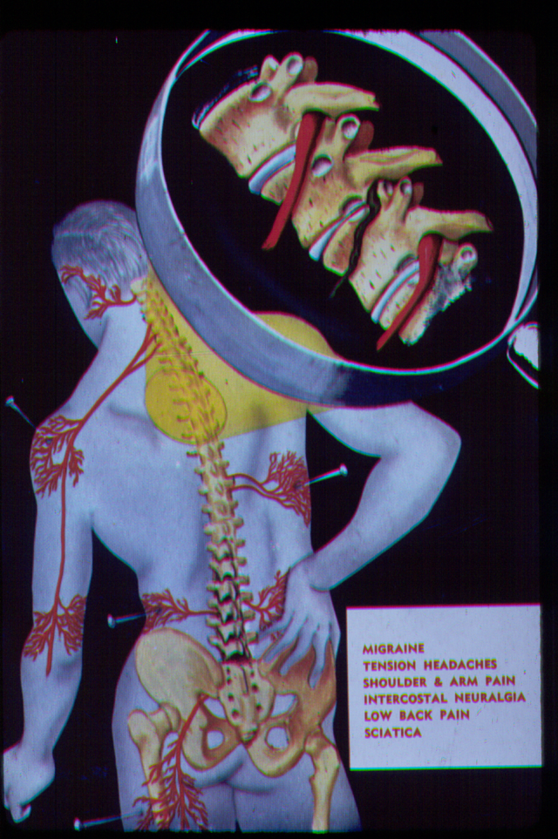
Autonomic Response Testing
Autonomics innervate all joints and extracellular connective tissues…
Different types of proprioceptors and neurological pathways….all connect via autonomic and afferent/efferent pathways.

Slide 3
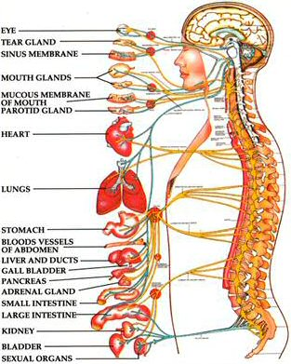
Autonomic Nervous System
Innervates everything – including all joints, viscera (guts), and extracellular tissue (outside the cell)
Operates entirely at the subconscious levels of the nervous system (Limbic and Reptilian Levels)

Slide 4
Types of Autonomic Responses Testing Methods
E.A.V. Polygraph testing
Thermography Galvanic Skin Response
Heart Rate Variability
Nogier Pulse Testing (Auriculocardiac Reflex)
Arm/Leg Length Reflexes
Manual Muscle Testing Procedures
They all involve baseline testing, various challenges, and retesting to identify response pattern

Slide 5
Muscle Response Testing
Response patterns of autonomic testing….
Is very suited for musculoskeletal problems…..
Its quick…
Its always present…
Its adaptable…
It is inexpensive…
Its response is…in real time….

Slide 6
Autonomic Response
Types of Response
  Normal – reaction with return to baseline
  Hyper – over-reaction with return
  Blocked – no response
  Hypo – under-reaction with slow return
  Reversed – opposite of normal

Slide 7
Types of Response
HYPER
Response
NORMAL
BLOCKED
REVERSED
Time

Slide 8
Manual Muscle Testing Methods
Have solid neurophysiological basis
Different levels/types of tests help to differentiate types of problems in the physical medicine realm….
Its important to study and know your anatomy and neurophysiology…

Slide 9
Challenge Methods for the Differentiation
Even though there is an anatomical & neurophysiological basis to all of this….
That information isn’t the purpose of this presentation!!!
Demonstrating its use is……

Slide 10
Screening Methods
Summary
Find the Area/Areas…
  Central, Spinal, Extremity, Visceral
Challenge the functional compartments
  Flexion, Extension, Abd/Adduction, Rotation, Lateral/Medial etc.
Determine the type of problem/condition affecting the area….
  Fascial, Ligament, Joint, Discal, Neuropathic

Slide 11
Challenge the Central Nervous System
Brain Stem & Spine Act
Like a “Central Subway” or Main Skytrain System

Slide 12
Central Nervous System
  Trains go back and forth along a central routing system
  When all goes well everything is quick and efficient
  When one area gets in “trouble” the whole system begins to back up becoming “dysfunctional”.

Slide 13
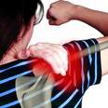

Central Nervous System Disrupted

Slide 14
Challenge the Peripheral Nervous System
Routes connecting to outlying areas “the suburbs” =extremities
Connects to spinal (central) system at connecting terminals or hubs called –
  Nerve plexi or
  Nerve ganglia

Slide 15
Peripheral Nervous System
Hubs
Connect
From Outlying
Areas to
Central Nervous System

Slide 16
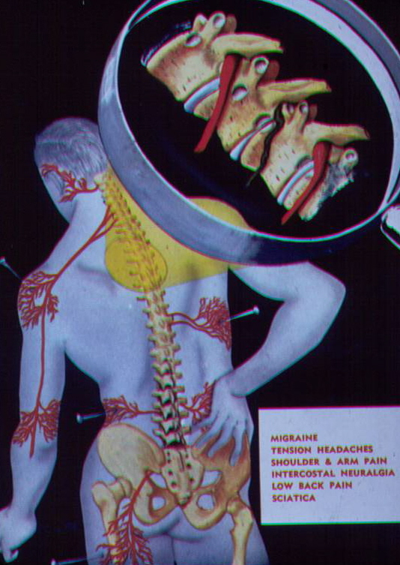
Challenge the Autonomic Nervous System
Automatic Internal Processing

Slide 17
Autonomic Nervous System
Sympathetic
Parasympathetic
Enteric

Slide 18
Cervical Spine
Screening Challenge
Rotation (Upper Cervical)
Lateral Flex (Mid Cervical)
Compression (Disc & Facets)
Distraction (Ligaments)
Palpation & Challenge

Slide 19
Thoracic Spine
Screening Challenge
Shrug (Shoulders to ears)
Shoulder Displacement (Upper Ribs)↑↓
A-C Joint (Subclavius test)
S-C Joint (Push Challenge)
Coracoclavicular- (Int Rotation)
Coracohumeral (Ext Rotation)
Palpation & Challenge (Ribs, Vertebra)

Slide 20
Example: Screening
Low Back/Pelvis
Sitting Tests:
Supine Tests:
Prone Tests:

Slide 21
Lumbar Spine
Screening Challenges
Sitting
SI Sprain-Subluxation (Weak Abd)
SI Retraction A-P (with Abduction)
Iliolumbar Lig (Hip flexion &45 rot ipsi)
Iliolumbar Vertical (Fwd flex & opp lat)
Facets (Hip flex & lumbar extension)
Discs (Valsalva)
Palpation & Challenge

Slide 22
Lumbar Spine Pelvis
Screening Challenges
Supine
Plantar Flex/Extension
Roll Pattern (Hips Rotated)
Dural Torque Pattern (Neck and Hips)
Imbrication (Leg Traction with Block)
Hip (Anterior Drawer)
Hip (Posterior Drawer)

Slide 23
Lumbar Spine Pelvis
Screening Challenges
Prone
Hip Extensors – Neutral (Glut max)
Hip Extensors – Sphinx position
Piriformis Test – Neutral position
Piriformis Test – Flexed hip position
Sacral Challenges – “Figure 8”
Sacro-coccyx Challenges
Lumbo-Pelvic Fascial Challenges

Slide 24
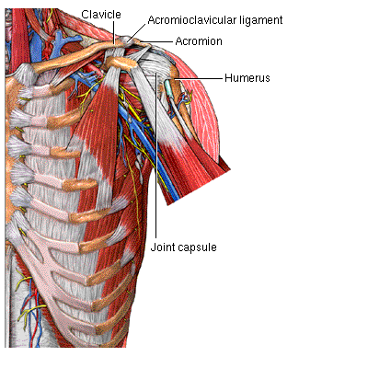
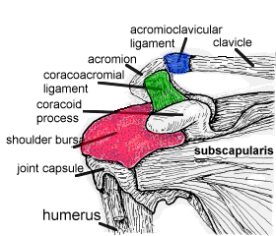
The Shoulder
– A Complex Structure

Slide 25
Example: Shoulder-
Divide the Functions and Test
Flexors- Biceps shorthead, longhead, anterior deltoid, coracobrachialis
  Abductors – mid-deltoid, supraspinatus, post-deltoid
  Adductors – Pec major clavicular, sternal, pec minor, subclavius
  Extensors- longhead triceps, post deltoid
  Rotators – teres minor, infraspinatus (3 div), subscapularis (3 div),
Ligaments- Capsular, Glenohumeral, Acromioclavicular, Coracoacromial (conoid, trapezoid), Sternoclavicular etc.

Slide 26
Manual Muscle Testing
Shoulder Exam
Coracobrachialis
Anterior deltoid
Middle deltoid
Posterior deltoid
Supraspinatus
Biceps longhead
Pectoralis minor
Pectoralis major sternal
Pectoralis major clavicular
Subclavius
Serratus anterior
Biceps shorthead

Slide 27
Manual Muscle Testing
Shoulder Exam (cont’d)
Triceps lateral head
Triceps medial head
Triceps longhead
Teres minor
Infraspinatus (lower)
Infraspinatus (upper)
Subscapularis (lower)
Subscapularis (upper)
Rhomboids
Levator scapula
Teres major
Latissimus dorsi
Upper Trapeziius
Middle Trapezius
Lower Trapezius

Slide 28
Functional Muscle Testing Exam
Shoulder
THORACIC SPINE & SHOULDER
Shrug Test (Shoulders to ears)
Shoulder Displacement (Upper Ribs)
Forced Adduction Stress Test
A-C Joint (Subclavius test)
S-C Joint (Push challenge test)
Apprehension Test (Ant. Capsule)
Coracohumeral ligament (Ext Rot challenge)
Coracoclavicular- (Internal Rotation)
Coracoclavicular-Trapezoid Lig (Lat. Rot)
Coracoclavicular-Conoid Lig. (Wing pull on scapula)
Active Compression Test (Biceps/Labrum)
(80° flexion, Full I.R., slight adduction)

Slide 29
Details: Differential Diagnosis of the Pain Generators in the Problem Area
Once you have found the area eliciting abnormal reaction patterns….
Process to find the types of problems eliciting the abnormal response in the region….

Slide 30
Challenge Methods for the Differentiation
    A. Skin/Scar
    B. Fascial Torque/Pull
    C. Joint Subluxations
    D. Muscle Weaknesses/Inhibition
    E. Ligament Instability
    F. Facet Joints
    G. Disc Problems

Slide 31
A. Skin/Scar/Fascia
Method 1
  Find intact muscle with resisted challenge
  Stretch the muscle quickly and retest
  Normal = no change of strength
  Abnormal = muscle weakens dramatically

Slide 32
Skin/Scar/Fascia
Method cont’d
  Use normal intact muscle and find an area that with light pressure reacts to stretch or pull directionally.
  Find direction that releases/corrects weakening or palpate and test to locate nodules or trigger points within tissue

Slide 33
B. Muscle Challenge Technique
Position fibres so they have appropriate elongation & vector positioning – muscles are rubber bands – they can only contract – they don’t push.
Begin resistance in consistent direction to feel for contraction strength.
A “weak” muscle will elongate when it shouldn’t, or fail to load and resist initially.
Look to its components and nerve supply.

Slide 34
C. Joint Challenge Technique
Test muscles around the joint – strong or not?
Twist, push, or compress joint while testing either a direct joint related muscle or an non-related indicator muscle for change.
Find the direction that strengthens a weak indicator and treat joint accordingly (joint/facet protocols)

Slide 35
D.Tendons
Become activated when the muscle contracts – pain usually at junctional areas.
Weakness or pain elicited is negated with approximation of injured site or amplified by distraction of fibres.
In the tendon itself compression of swollen fibres is painful – you can feel the “boggy” tissue
Treatment involves appropriate ligament repair – take pressure off structures, consider prolotherapy, and microcurrent or ATP enhancement therapies.

Slide 36
D. Tendon Challenge Technique
Test intact muscle
Activate tendon and touch areas until you locate precise areas that change response.
Use varied directional pressures to identify the appropriate patterns of normalizing response.

Slide 37
E. Ligament Challenge Technique
Test joint for normal muscle activation
Challenge joint/ligament complex by pushing joint in specific direction that activates the ligament to respond.
Retest the muscle – positive response the muscle will weaken.
Note: some muscles have direct ligament associations and are more specific.
  Eg. Popliteus muscle and posterior cruciate ligament

Slide 38
E. Ligaments
Treatment for grade II injuries involves: Increasing blood flow and repair factors and stopping tearing/ microtearing while repairing.
  Joint positioning
  Reset of fibro-osseous junctions,
  RIT/Prolotherapy,
  Taping or stabilization while repairing.
  Appropriate nutritional support – Collagen & Matrix

Slide 39
F. Disc Challenge Technique
Similar to joint challenges – but involve compression, shearing, or distraction of disc between the bones.
Treatment is similar to ligament except it is deep – can’t directly inject because of central pain component.
Stabilize around the disc –all supportive structures – and get “healing currents” through the tissue.

Slide 40
G. The Cerebrospinal Fluid System
We need to add this in because…..
Its a hydraulic – “rheostat” electrical system
(If its not working- functionally you are a “dim lit”)
Important to the nervous system
Intimately related – as a structural and trophic physiological support system that pumps circulation/nutrition/waste removal for the nervous system.

Slide 41
G. The CSF System
Generally overlooked by traditional medicine
Definitely overlooked/excluded by WCB etc.
The power source for musculoskeletal- energy functions
Critical in concussion and all autonomic response issues.

Slide 42
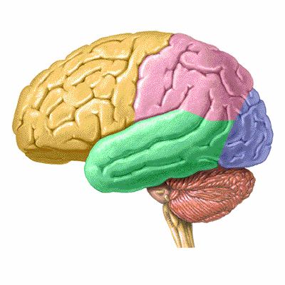
G. Cranial Challenge Technique
Demonstration

Slide 43
Phase of Injury & Healing Cycle
INJURY
Inflammation – PG2 Release, Cytokines
Spasm – Splinting Actions
Deposition – Stabilization/Patching with GAG’s, minerals,
Remove wastes - Enzymes
Remodeling Fibrosis or Hypermobility
Loss of Elasticity Loss of Elasticity
Loss of Flexibility Loss of Strength
Pain Generator Pain Generator
ACUTE
SUBACUTE
CHRONIC

Slide 44
Acute Treatments
Inflammatory
Reduce tissue leaking, bleeding, and restore tissue membrane integrity as soon as possible.
Restore proper integration within system
  Nervous system, acupuncture systems
  Concussion protocols, CSF, Spinal
Stabilize and support system for repair

Slide 45
Chronic Treatments
Activate circulation and remove by-products of fibrosis/mineralization
Restore integration and communication of tissues
Activate tissue regeneration and repair
Be aware of subacute and awakened inflammatory start up process

Slide 46
Think of General Principle Regarding Connective Tissue Repair
Fascial related structures heal with scars/fibrosis…..glue, sew, and shrink wrap process
Ligaments and related tissues get lax and lose elasticity…weakness/ loss of power through weakening of tensile components

Slide 47
Stability/Instability
Changing the boney architecture – changes the tensegrity
Tear/cut/shear in the connective tissue matrix = changes in the tensegrity of the matrix
= changes the reflex proprioceptors all the way to the brain.

Slide 48
Naturopathic Tools That Work!!!
Hands on – Soft Tissue Manipulation
Manual and Joint Manipulation
Frequency Specific Microcurrent FSM
Acupuncture – Dry Needling, IMS
Neural Therapy
Regeneration Injection Therapy
Cranial Sacral Therapy

Slide 49
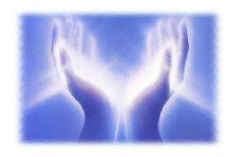
Joint and Soft Tissue Manipulation
You don’t need to pile drive the tissues!!! And create more damage…..
Skill and proper assessment – and a feel for the tissues makes a huge difference
Use the body’s “alert response”, aka “autonomic response”, via “primitive reptilian system”, the towards and away from response of all living cells…..

Slide 50
Tissue Manipulation
We are working to restore proprioceptor feedback function
By setting the tissues back in proper physiological relationship
So they can heal and restore proper cell signaling within the extracellular matrix and nervous system
Learn how to work with the many types of proprioceptors in the body.

Slide 51
Frequency Specific Microcurrent
Dr. Carol McMakin, DC, Portland, Oregon
Learning & developing the frequency based “Language of the Tissues/Body”
You need two channels –
You need very specific frequencies
Research proves it…

Slide 52
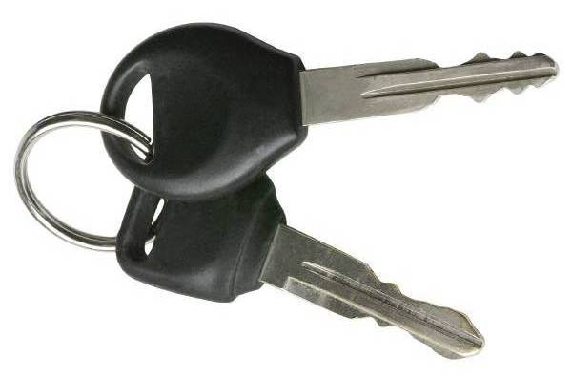
BIOLOGIC RESONANCE
“Living matter responds to coherent signals.”
James Oschman, PhD
Drugs or nutrients can act like keys in a lock
to change membrane protein and cell function
Frequencies act like the beeper that
opens the door with an electromagnetic signal
  May change membrane protein
  configuration and function
  electromagnetically

Slide 53
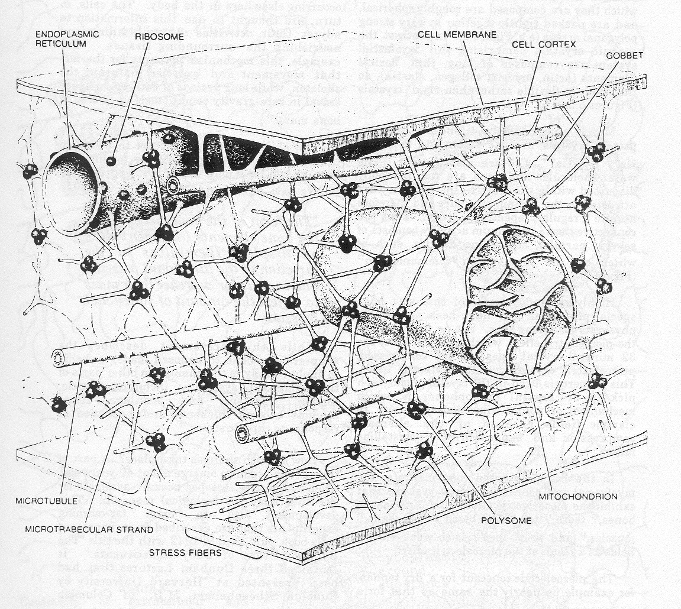
Biologic Resonance
Inflammation is not only a biochemical phenomenon
Inflammation is an electromagnetic pattern
Neutralized by a
corrective pattern
LOX Inflammation
IL-1

Slide 54
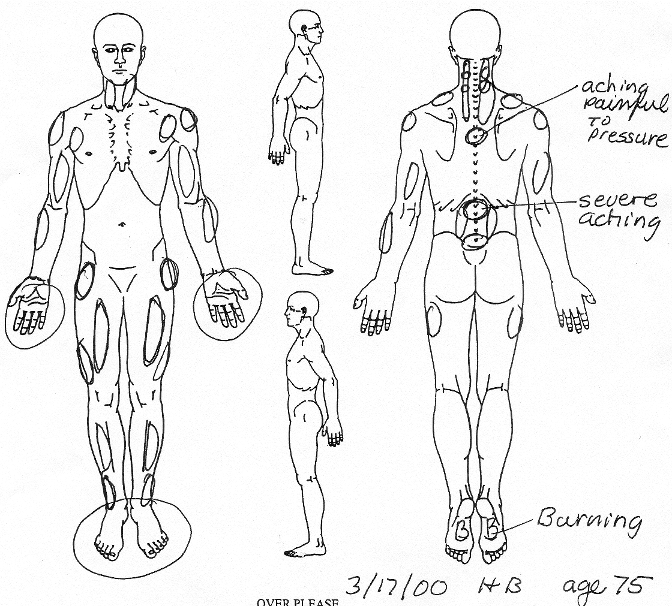
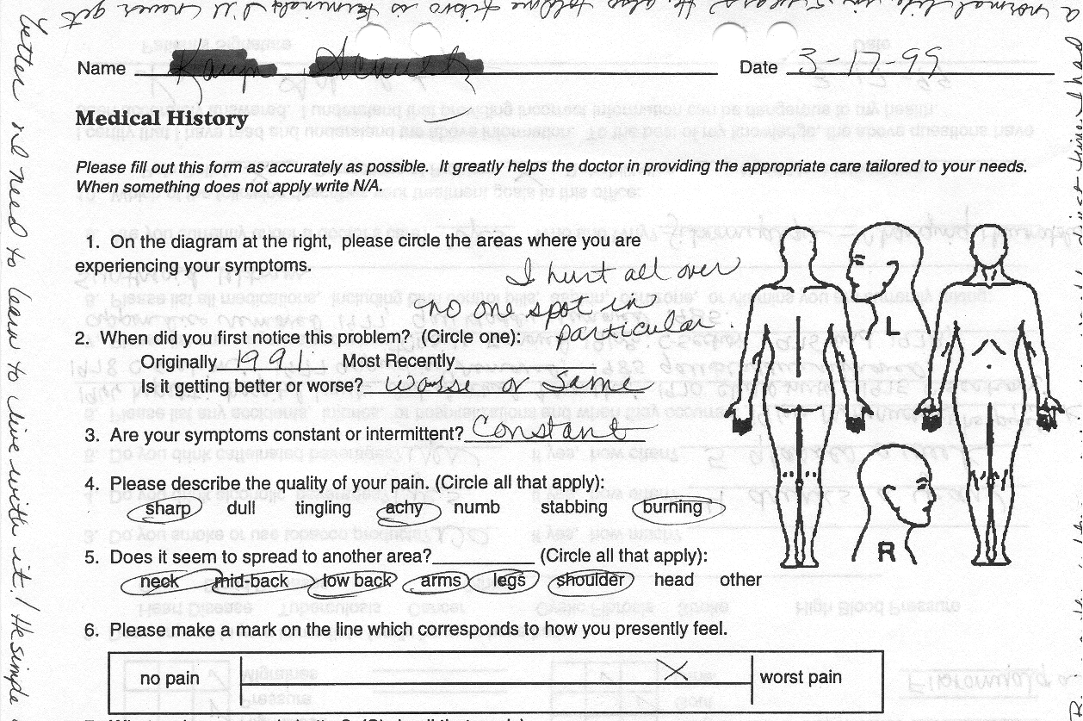
Fibromyalgia from Spine Trauma
C. McMakin, W. Gregory, T. Phillips, JBMT, July 2005, 9 169-176
Pain 7.3 ± 1.2 / 10 (range 5-10/10)
  Resistant to narcotics
  Aching, burning, tingling, stabbing
54 Patients
  9.5 yrs avg CHRONIC (1-50 years)
  Met ACR Fibro criteria
PAIN PATTERN
  Neck, midscapular
  Shoulder, arm, hand
  Back, leg, foot pain
Patellar reflex +3/4

Slide 55
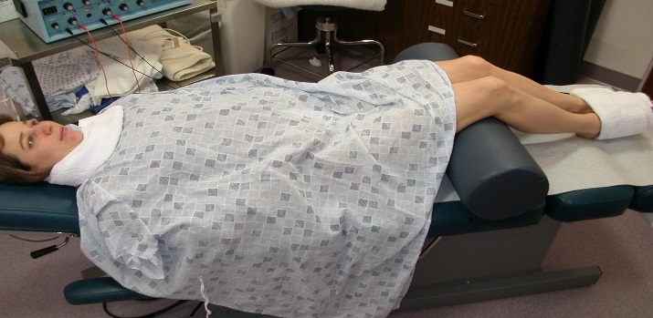
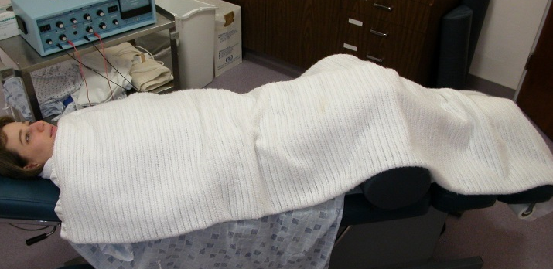
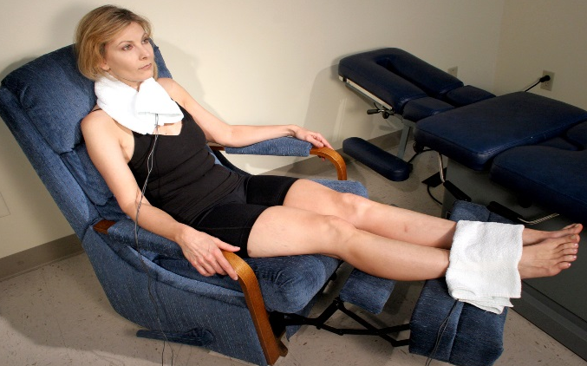
FSM Treatment Protocol
40hz, 10hz only effective frequencies
  Polarized + DC current
Pain reduced 7.4 to 1.3/10 in 90 min
  Lasts 1 hour to two weeks
Neuroendocrine recovery in 2-4 months
Individualized recovery program
  FSM in office, FSM home unit
  Physical therapy, reconditioning
  Supplements
Medication management / withdrawal

Slide 56
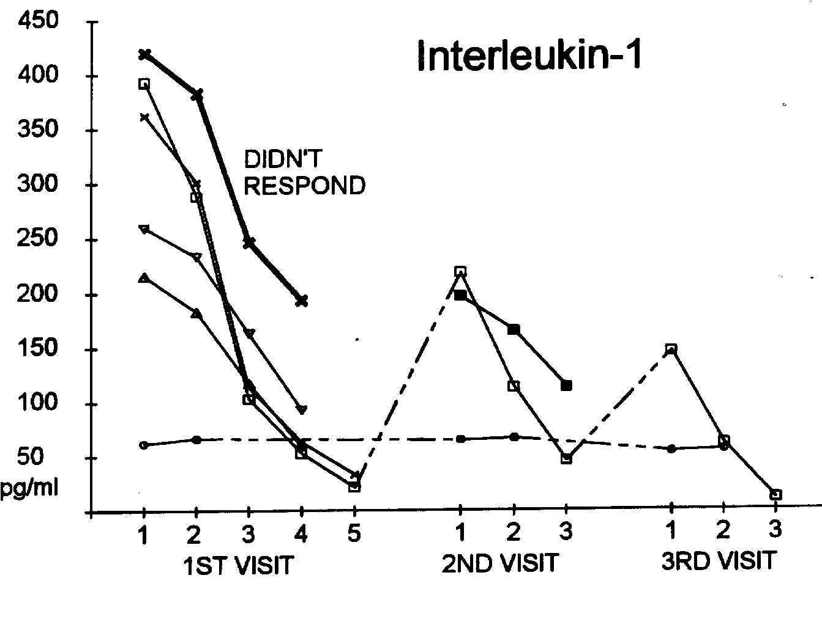
IL-1 normal= 0-25pg/ml
330 ± 39 reduced to 80 ± 31pg/ml P=0.004
Linear regression on time points P=0.0001
392.8
21.4

Slide 57
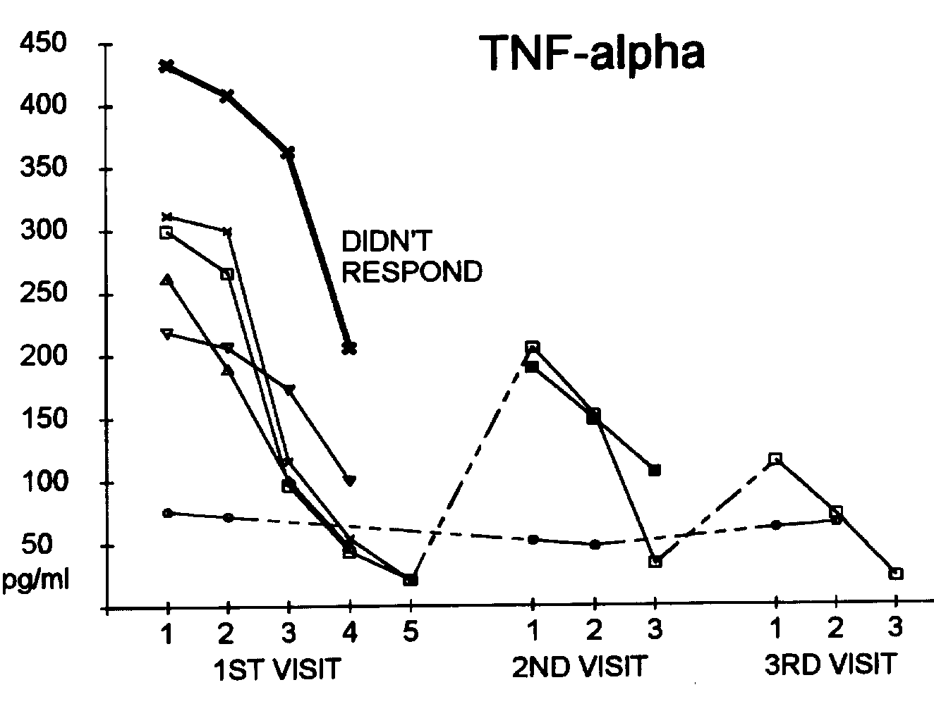
TNF-alpha normal=0-25pg/ml
305 ± 36 reduced to 78 ± 35 pg/ml P=0.002, t-test
299.1
20.6

Slide 58
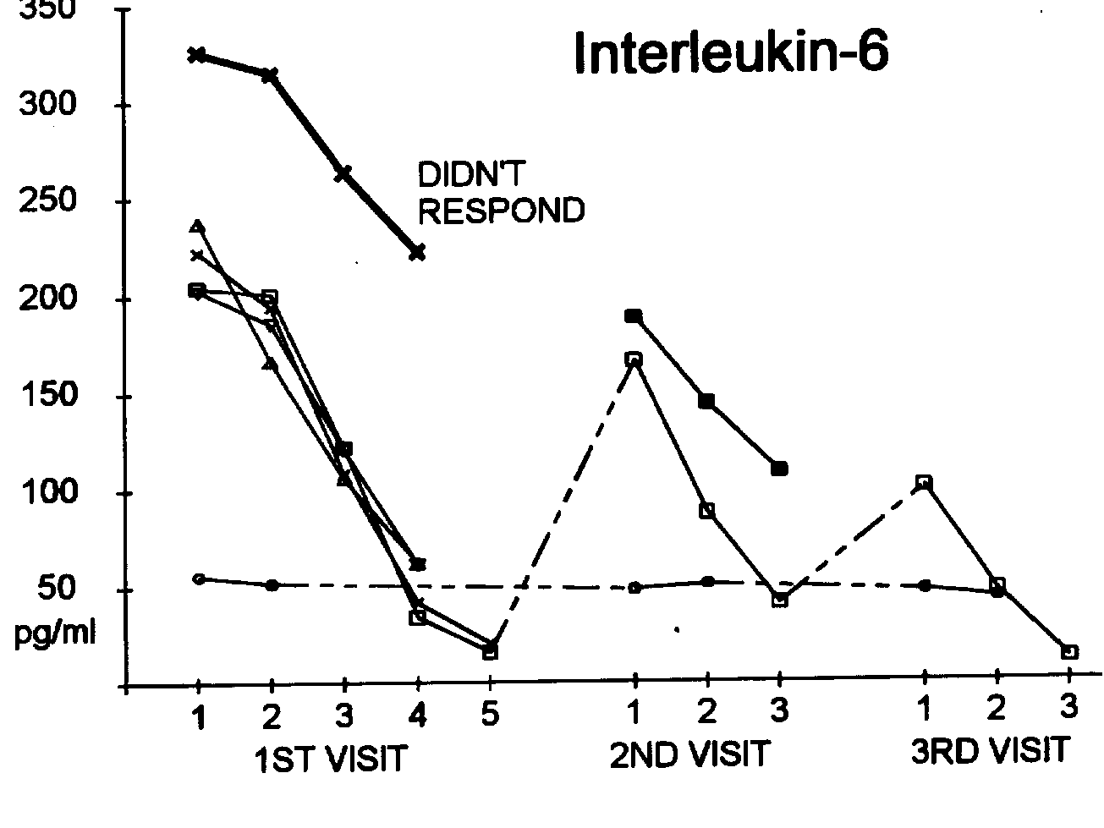
IL-6 normal=0.25pg/ml
239 ± 23 reduced to 76 ± 38 pg/ml P=0.008, t-test
204.3
15.6

Slide 59
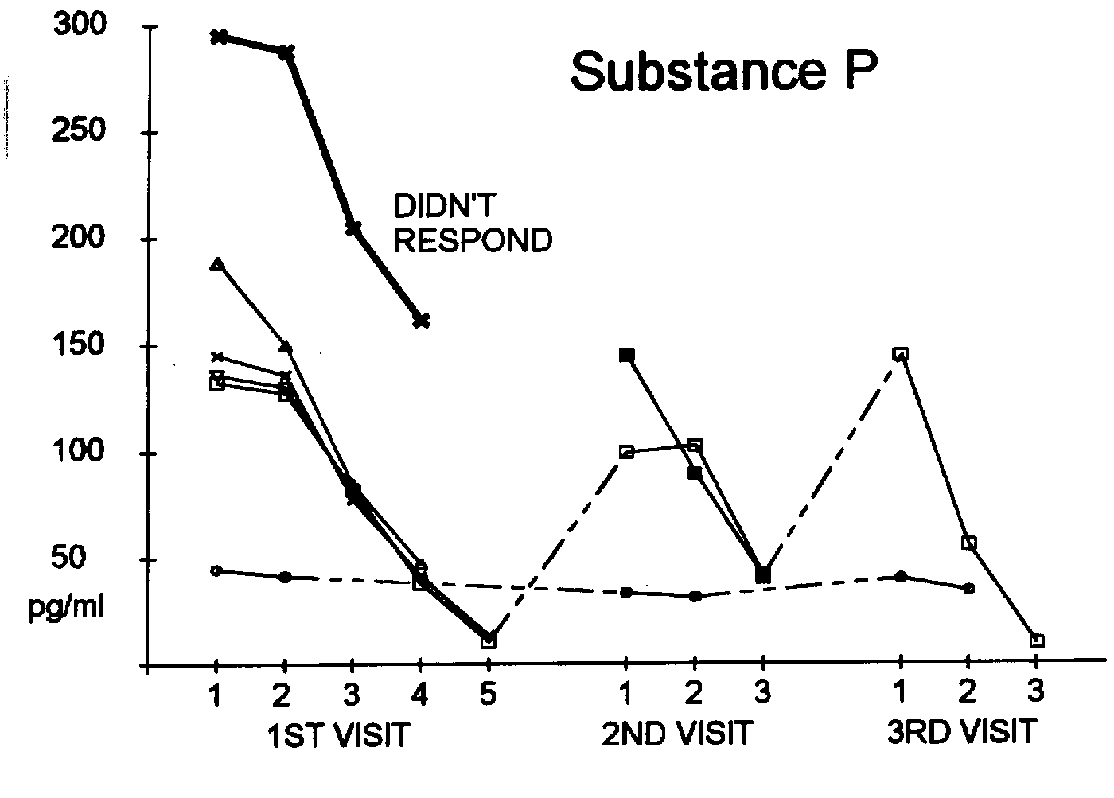
Substance P normal=0-30pg/ml
180 ± 31 reduced to 54 ± 28 pg/ml
P=0.0001, t-test
132.6
10.5

Slide 60
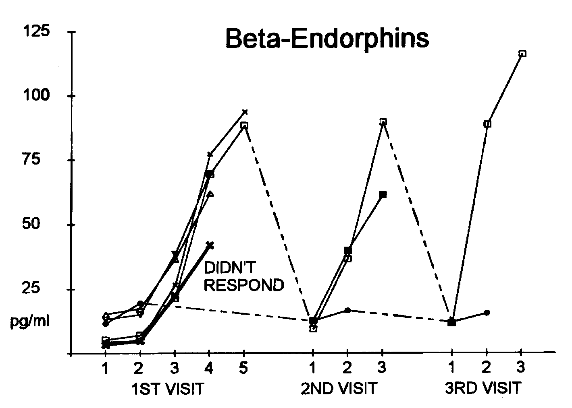
Beta Endorphin normal 0-35 pg/ml
8.2 ± 2.5 increased to 71.1 ± 9.3 pg/ml
P=0.003, t-test
88.3
5.2

Slide 61
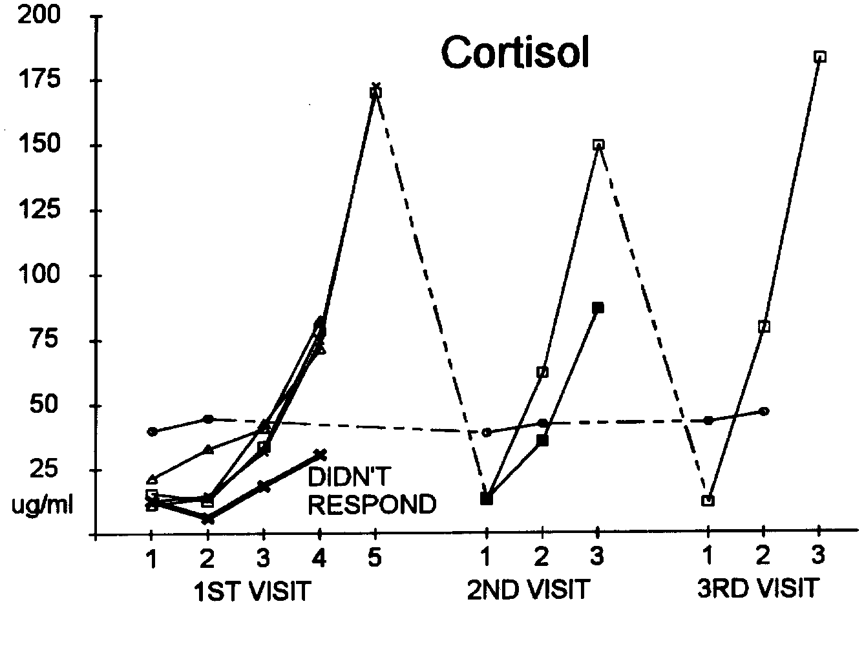
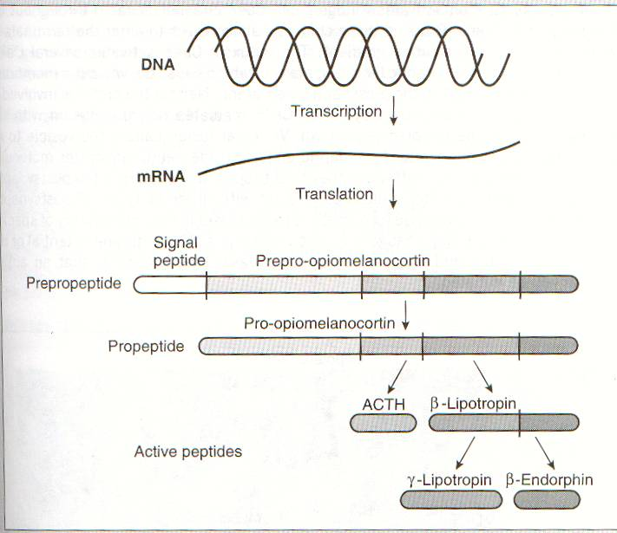
Cortisol normal 5-25 ug/ml
14.7 ± 1.8 increased to105.3 ± 28.2 pg/ml P=0.03, t-test
169.9
15.5
Not a stress response
Cortisol follows endorphins
Neuropeptide-Y drops

Slide 62
Pain Relief - Recovery
VAS 7.3 ± 1.2 to 1.3 ± 1.1
  P <0.0001
  90 minutes first treatment
  40 minutes subsequent treatments
All patients had pain relief
58% (31/53) recovered from fibromyalgia in four months
7.3 / 10
1.3/10

Slide 63
Optimal Response
18 years chronic fibromyalgia
12 / 8 : 14 / 18 tender points
1 / 12 : 11 / 18 tender points
2 / 8 : 7 / 18 tender points
  Cervical ROM improved by 40%
  Pain medication reduced by 95%
  Muscle relaxants reduced by 95%
  Sleeping well, no medication
  Digestion improved, IBS resolved
6 year follow-up – Recovery Maintained

Slide 64
Fibromyalgia - Outcome
The most important thing
you need to know about Fibromyalgia
is that it is curable ….
Not in every case, and not in every patient, but it is curable often enough that a cure can be the intended treatment goal

Slide 65
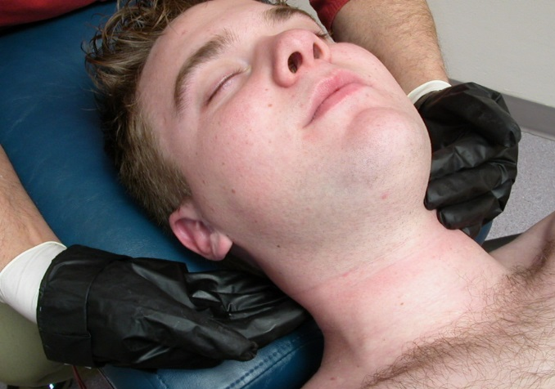
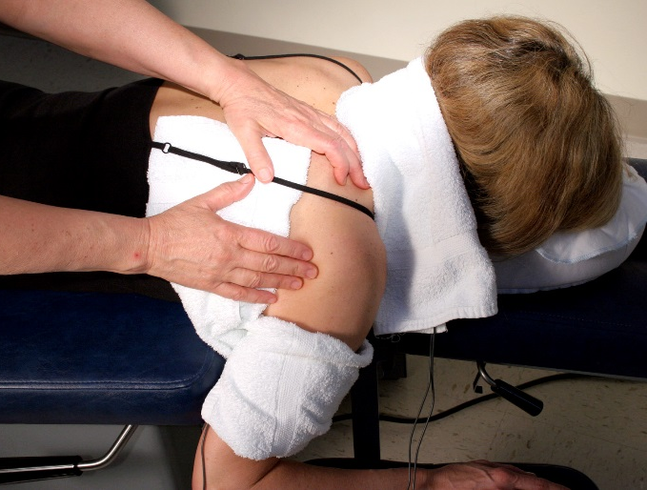
Cervical Myofascial Pain
50 Cases published – TICC, 1998
4.7 yrs avg chronicity
  Range: 1 to 28 years
  88% failed with other treatments
11.2 treatments
7.9 weeks (8 weeks)
6.8 /10 pain reduced to
1.5 /10

Slide 66
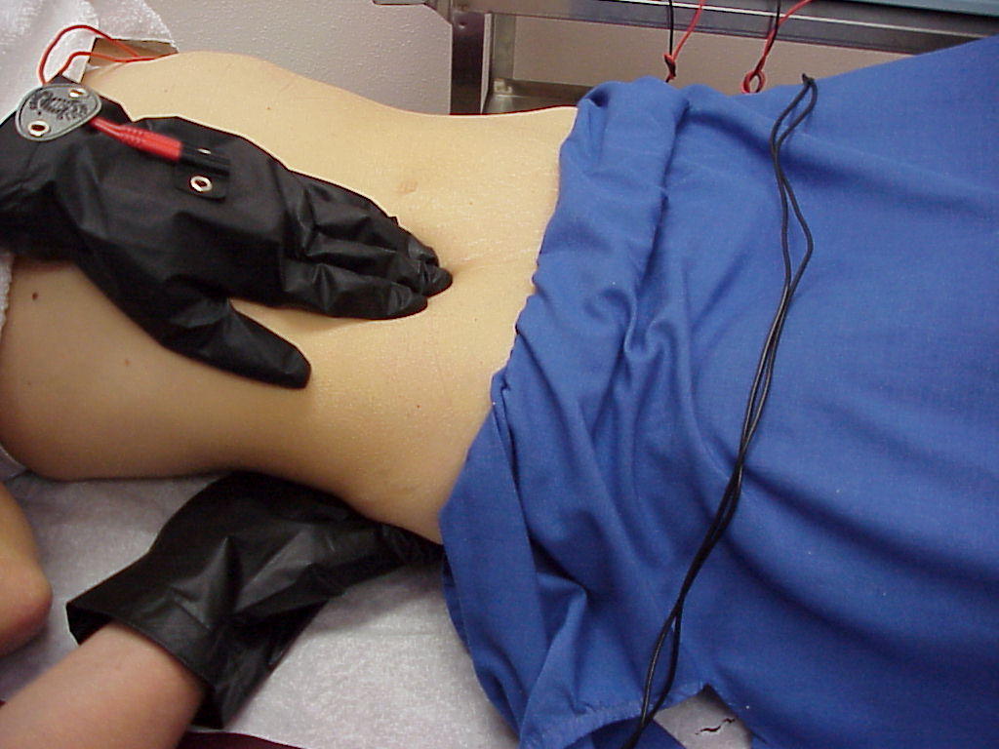
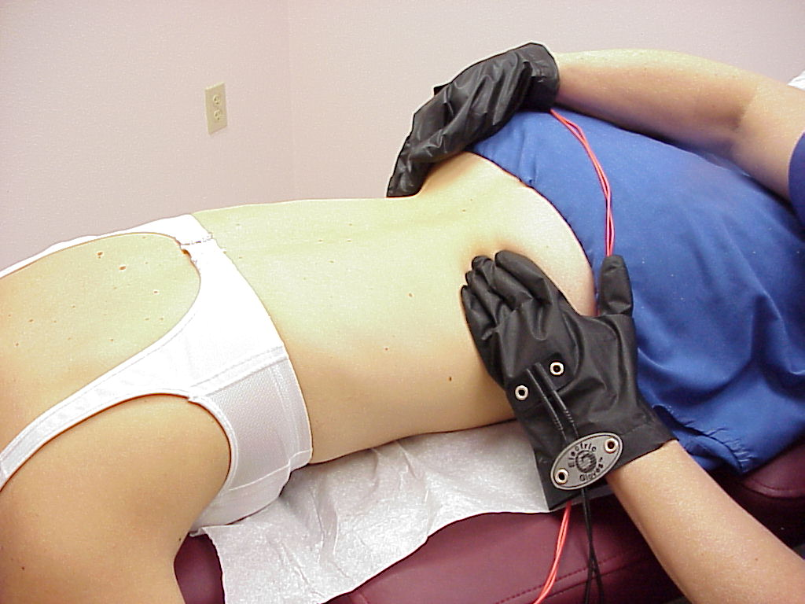
Lumbar Myofascial Pain
23 Cases Published - JBMT, 2004
8.4 years avg chronicity
  Range: .1 to 20 yrs
  87% failed with other treatments
5.7 treatments (6 tx)
5.7 weeks (6 weeks)
6.8 /10 pain reduced to
1.6 /10

Slide 67
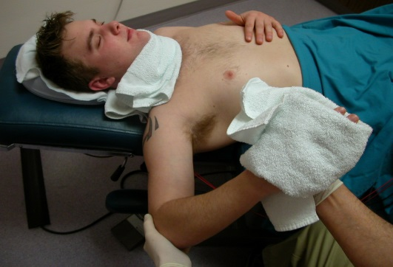
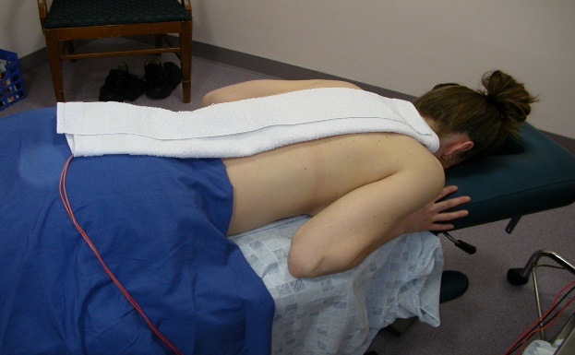
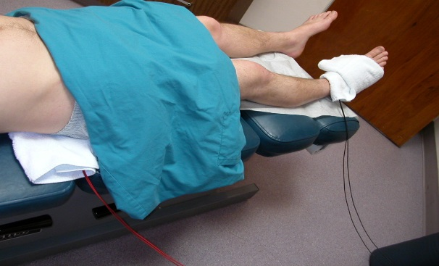
Treating Neuropathic Pain
Unpublished Data
N = 20
  Patient age 47.7 years (24 - 68 years)
6.7 years chronic (1 week- 44 years)
4.6 Treatments avg (1 - 15)
Mechanism
  Traction injury 2
  Disc 13
  Falls 1
  Other 3
  Unknown 1

Slide 68
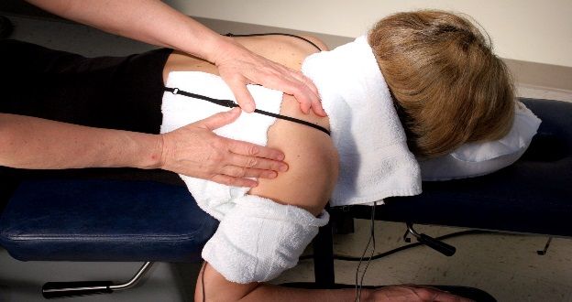
Outcomes in Neuropathic Pain
1st Tx = 6.8/10 (4-10/10) reduced to 1.8 /10 (0-8/10)
  P <.001
2nd Tx = 4.8/10 reduced to .97/10
  P<.001
65% fully recovered (n=13)
  4.6 Treatments (range 1-15)
25% terminated care prior to recovery (n=5)
1 person referred for epidural injection
1 person uses HomeCare unit for maintenance

Slide 69
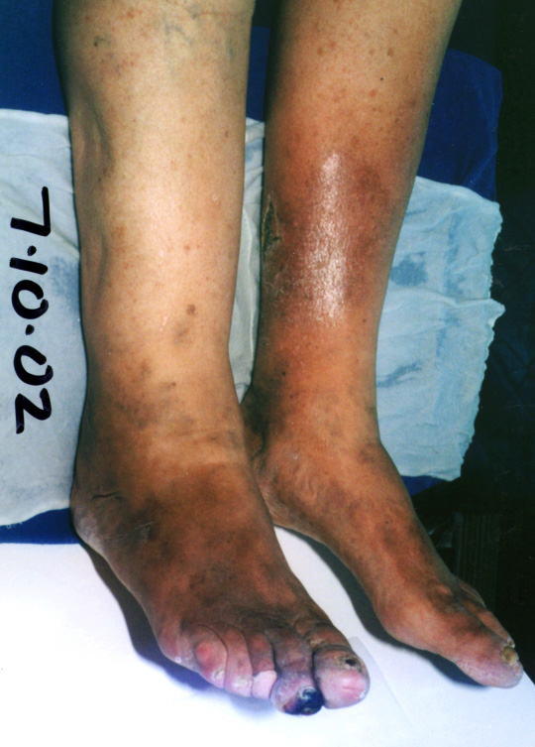
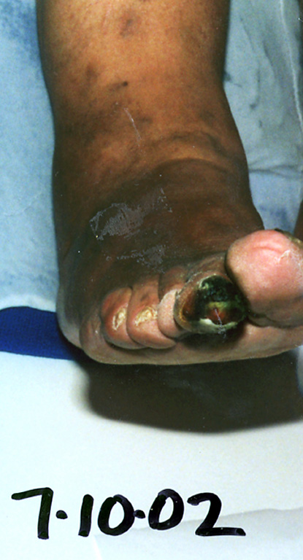
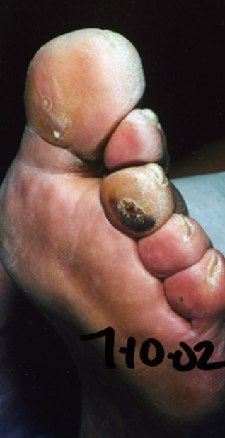
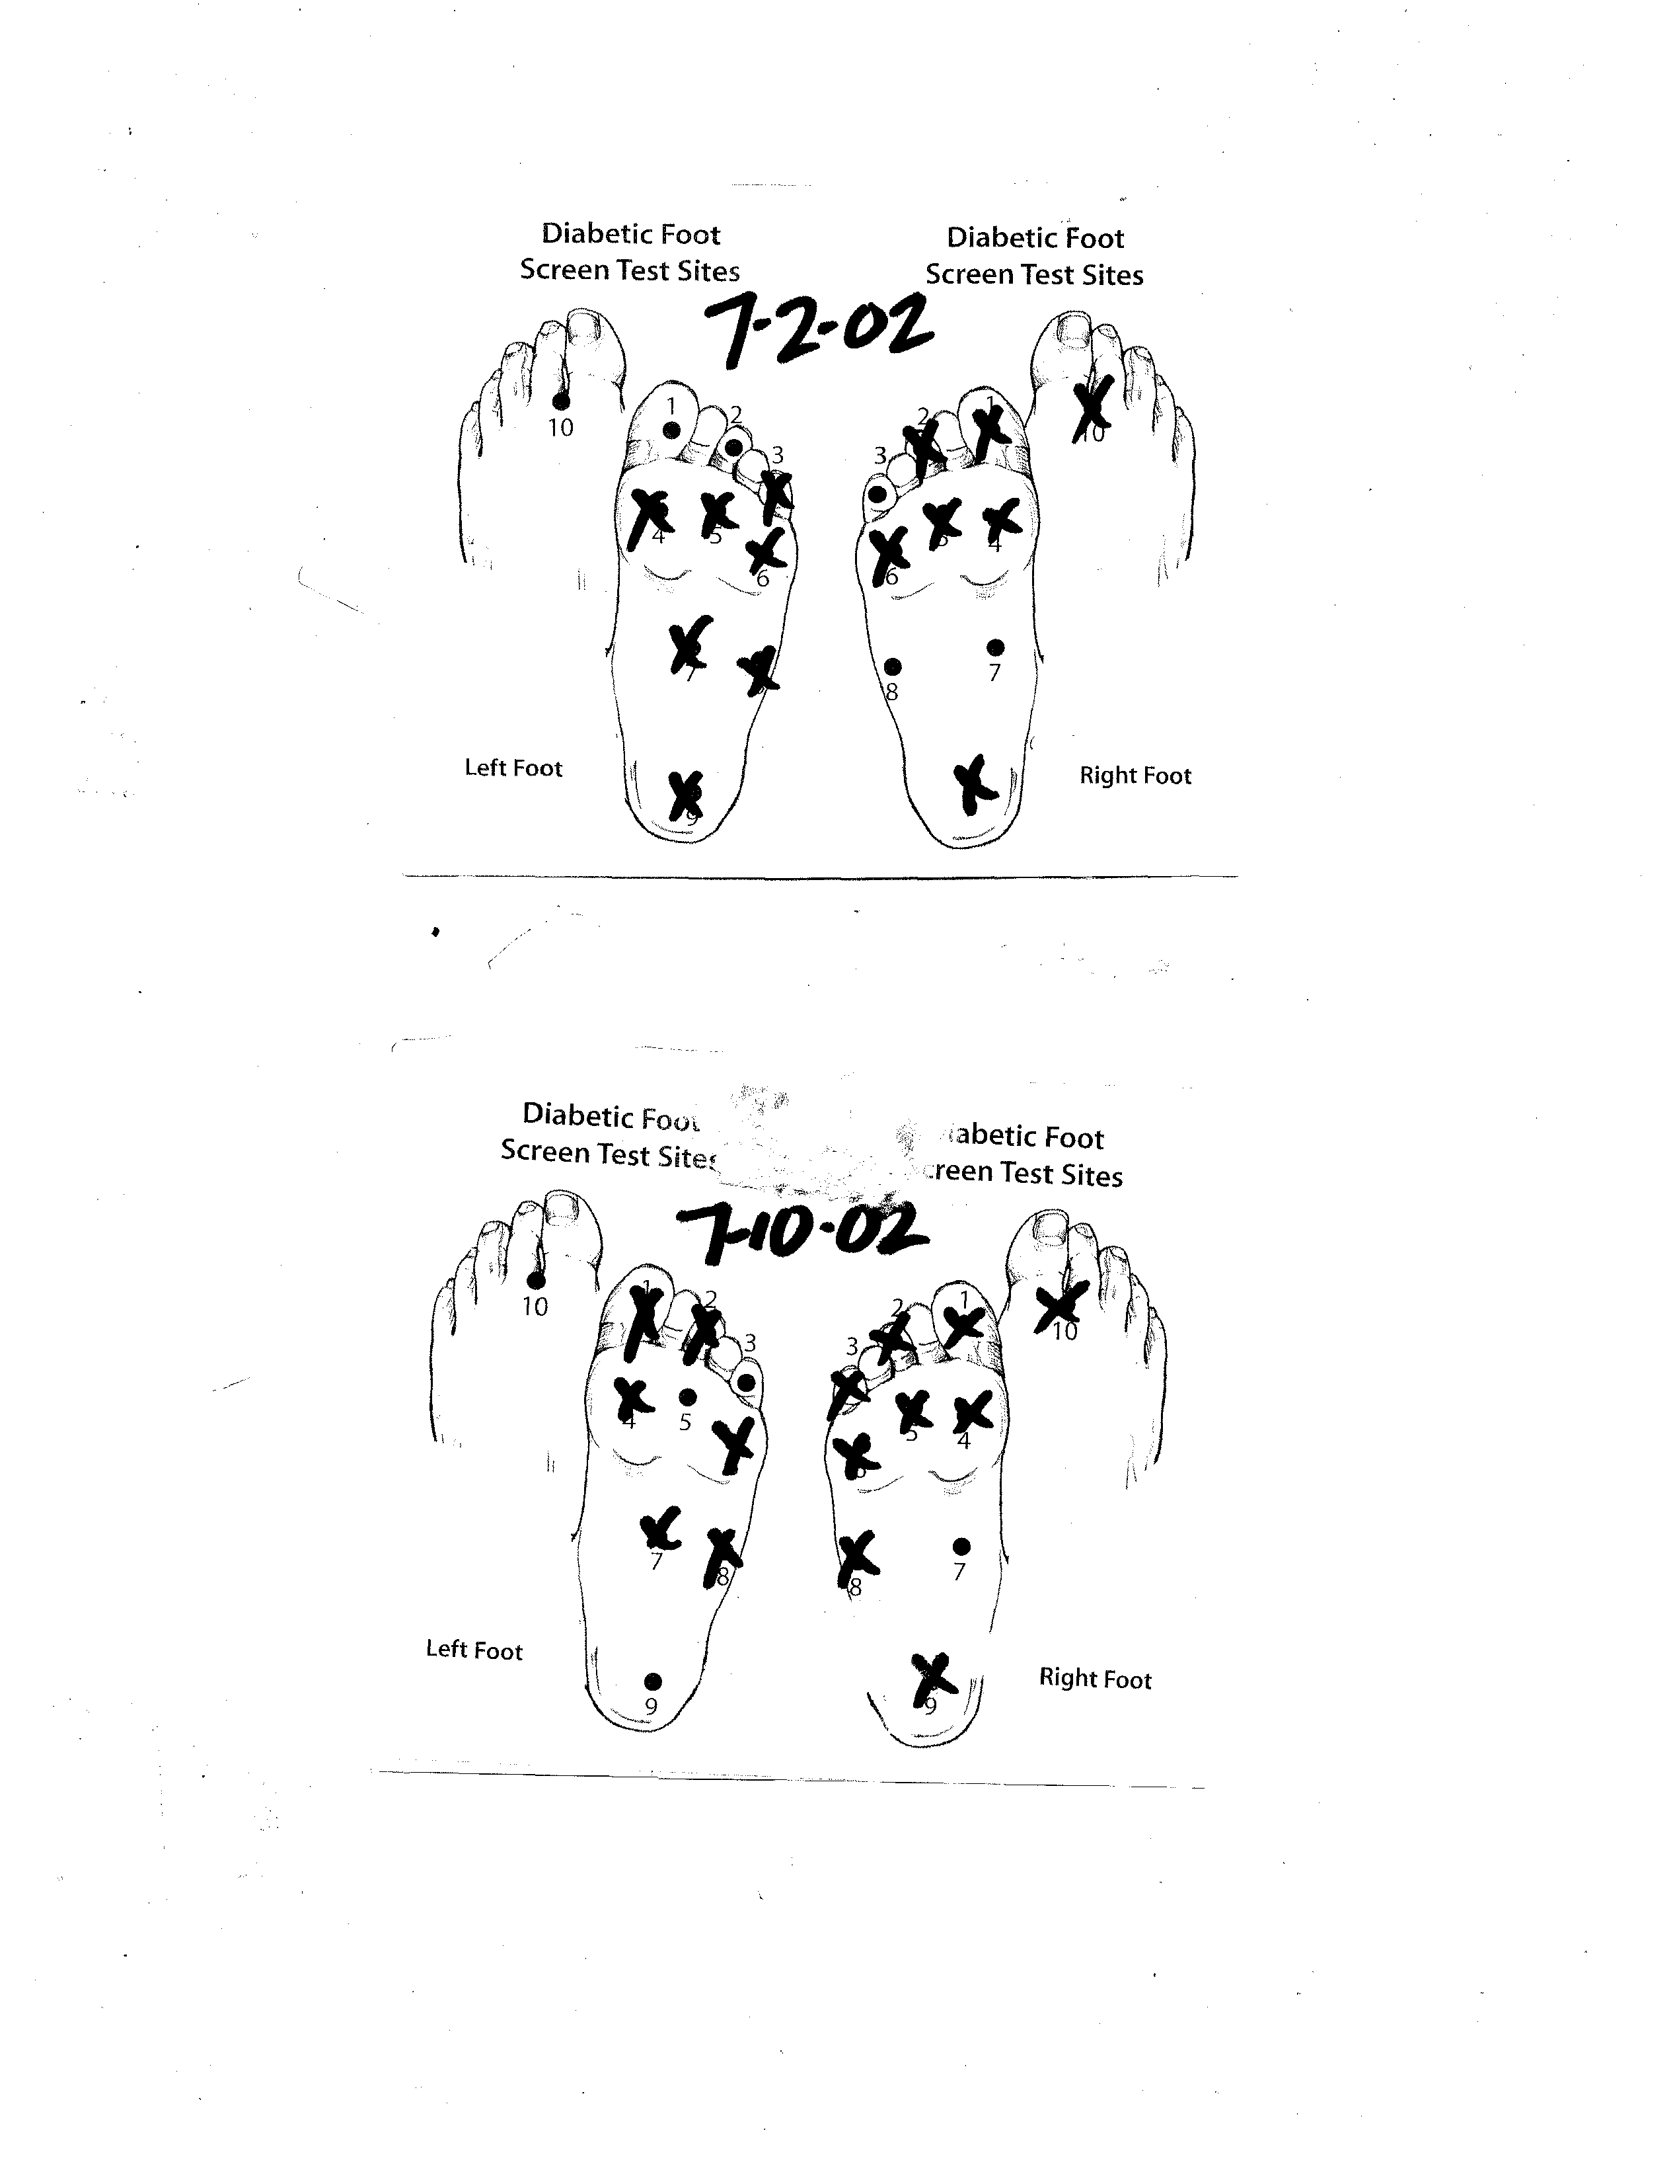
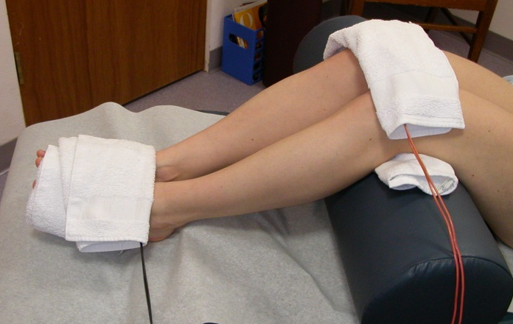
Diabetic Peripheral Neuropathy
7 cm ulcer
Both feet gray or mottled gray
Necrotic tissue right 2nd digit
Necrotic tissue left 3rd digit
Sensation loss in 7/10
All healed in 6 weeks
6 to 11 treatments

Slide 70
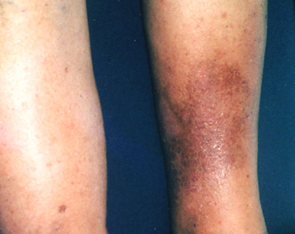
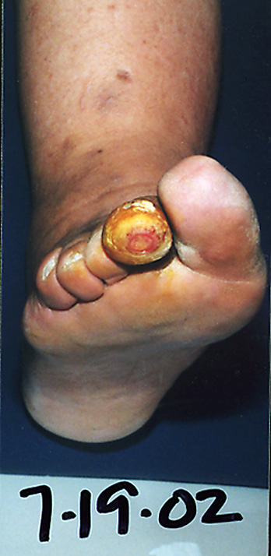
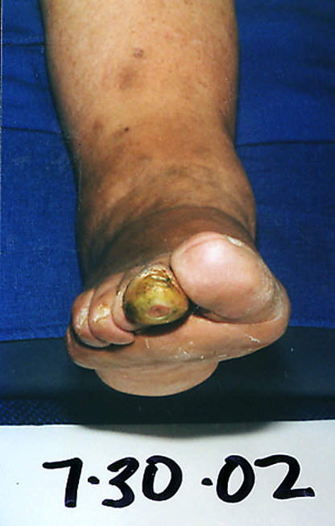
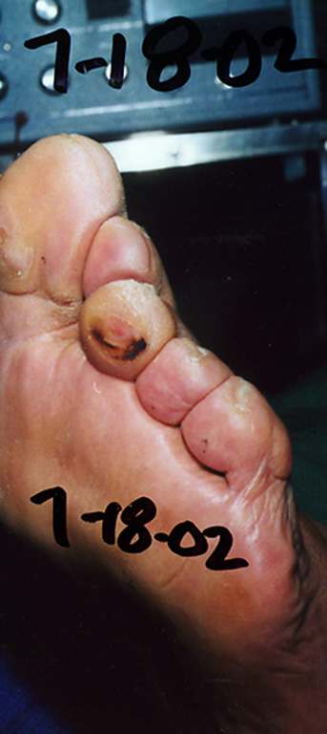
Restore Sensation – Heal Wounds

Slide 71
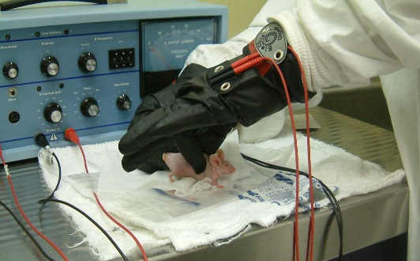
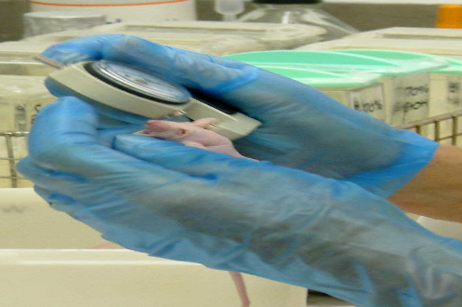
FSM Blinded Animal Research
V. Reeve, W. Reilly, U of Sydney, 2003
62% reduction - LOX inflammation
30% reduction - COX inflammation
All animals responded
4 Minute time dependent response
Control
40 / 116
Placebo

Slide 72
Frequency Specific Response
No other Frequency Reduced Inflammation
4 minutes of 0.1/0.1 Hz
no reduction
in ear swelling
4 minutes of 91/39, 59 Hz
no reduction
in ear swelling
4 minutes of 294, 321, 9/62 Hz
no reduction
in ear swelling

Slide 73
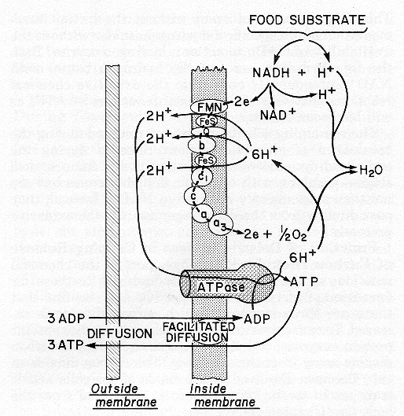
Microcurrent Increases ATP
10 – 500 micro amps
Increased ATP production 500%
Increased protein synthesis 70%
Increased amino acid transport 40%
Increases electron flow
Cheng N 1982, The Effect of Electric Currents on ATP Generation, Protein Synthesis and Membrane Transport in Rat Skin. Clinical Orthopedics 171: 264-272.

Slide 74
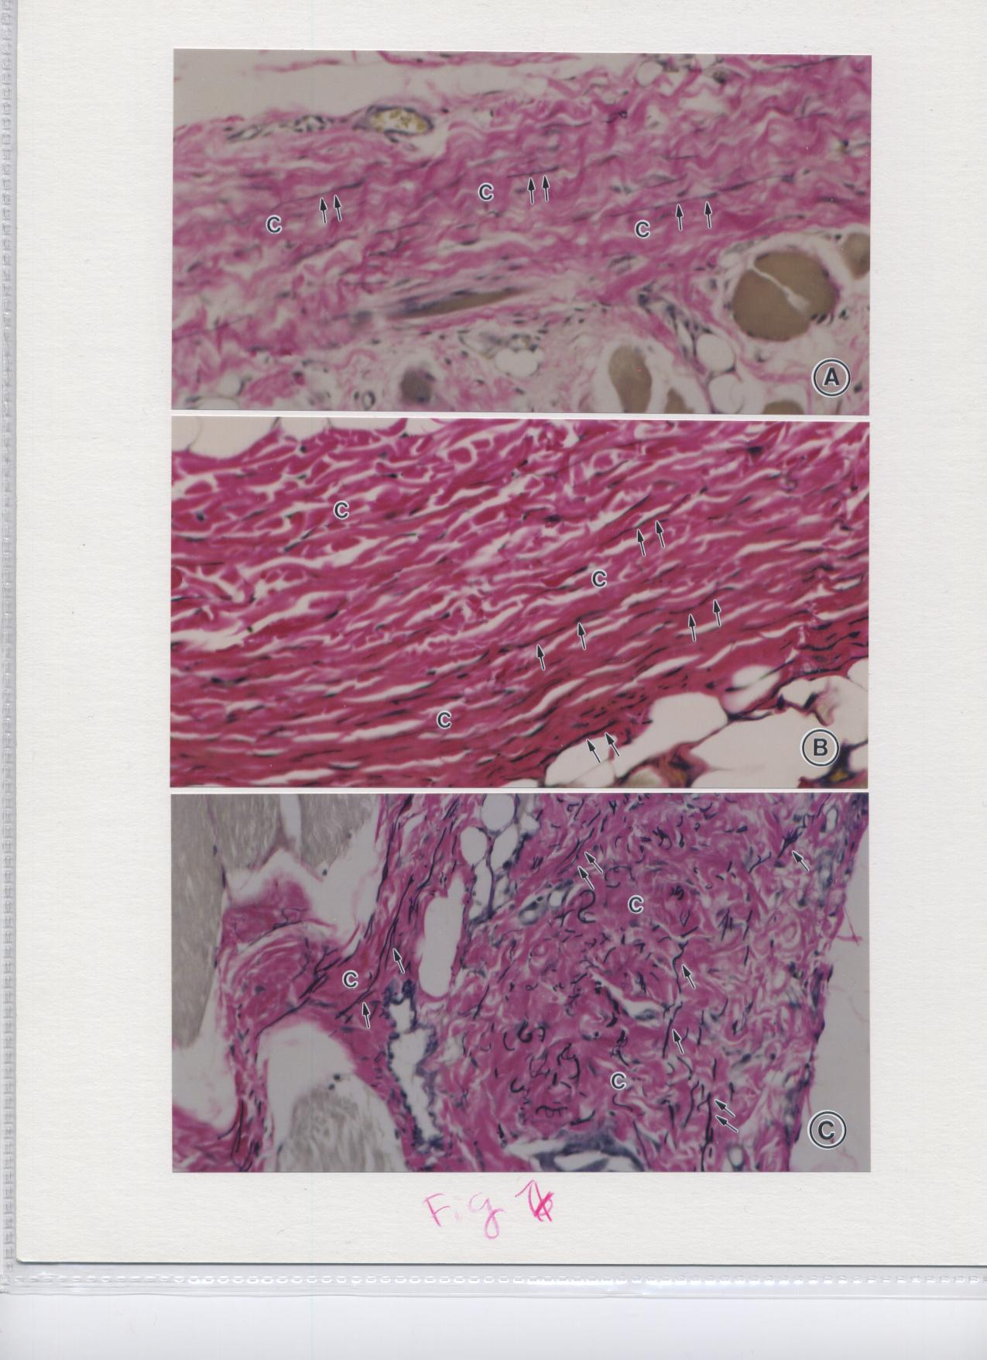
Collagen
14% increase over 20 days of treatment
Current at 0.3 Hz
Unpublished
University of Washington
Animal Study
Before
After
Notes:
74

Slide 75
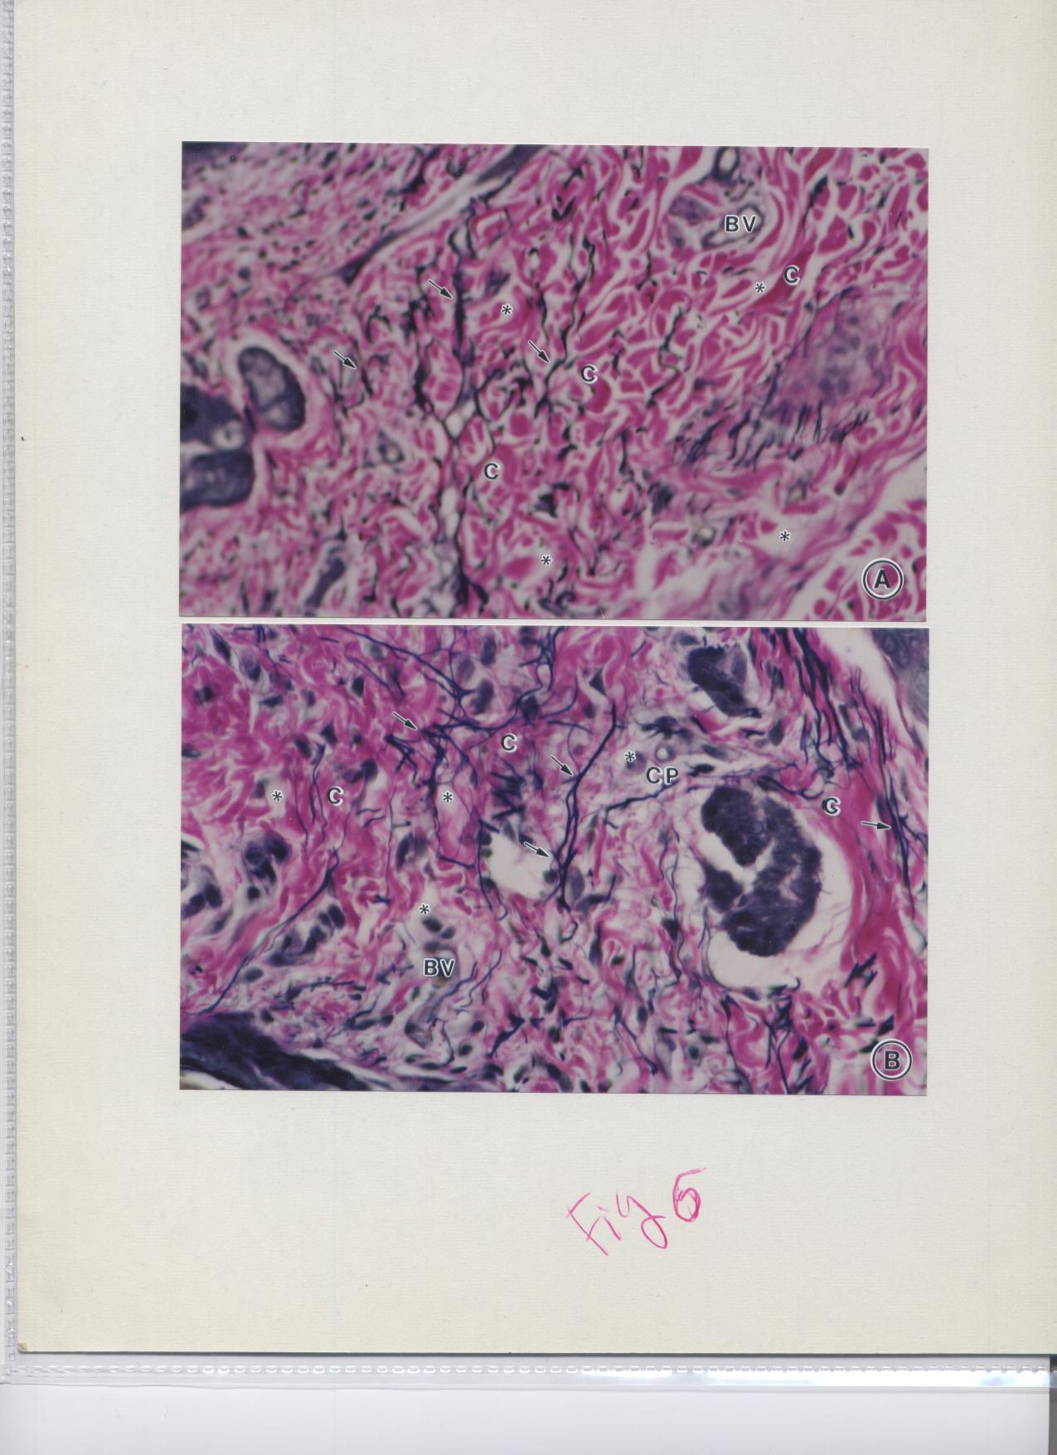
Elastin
48% increase over
20 days of treatment
Current at 0.3 Hz
Unpublished
University of Washington Animal Study
Before
After
Notes:
75

Slide 76
Frequency Specific Microcurrent
Changing the Paradigm
One Patient at a Time
Changing Lives
One Practitioner at a Time
www.frequencyspecific.com
Or Contact our clinic for more information/training

Slide 77
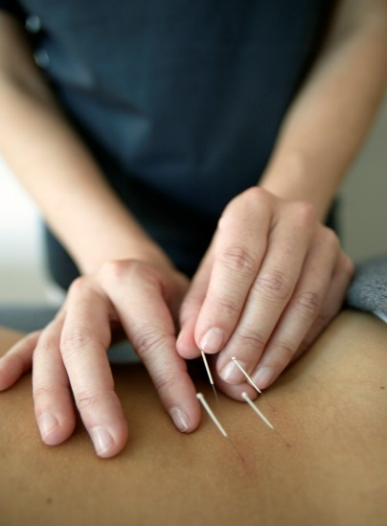
Acupuncture
Dry needling of trigger points – IMS
Cupping and release of stagnant chi as well as fibrosis/adhesive fascial layers

Slide 78
Neural Therapy
German “acupuncture” – uses needles plus the beneficial effects of procaine
Trigger point therapy
Scar injections – fascial adhesions
Different methods of application can result in different delivery effects – short, long term, dermatomal, etc.

Slide 79
Regeneration Injection Therapies (RIT)
Release of “growth factors” to stimulate repair and complete wound healing in inadequately repaired tissues to increase strength (rabbit tendon studies – 150%)
It is regeneration therapy and not the production of scars – ie-sclerotherapy. (Tissue biopsy studies)
Several types of procedures:
  Dextrose/procaine/-phenol,B12
  Autologous blood
  Platelet Rich Plasma

Slide 80
Prolotherapy
Procaine plus dextrose 7-15-25% concentrate
Procaine plus P2G – phenol, glycerine, glucose
Sodium morrhuate – (arachadonic acid?)
  Strong inflammatory reaction – have to be careful in application, not for beginners

Slide 81
Prolotherapy
Site specific – have to inject the right areas
Inject when “kissing the bone” – light contact on boney surface, fibro-osseous junctions, tendons.
Learn to feel the tissue with the needle
Need a good understanding of anatomy of the connective tissues and injection sites

Slide 82
PRP- Platelet Rich Plasma
Uses patient’s own blood – autologous cells
Platelets must be concentrated 5 fold or more for best effect
Concentrates growth factors and other factors for enhanced tissue regeneration
Specialized equipment/ medical procedure
More expensive than most other RIT
May be more effective when properly applied

Slide 83
The Potential of Naturopathic Medicine
For
The Good, The Bad, and the Ugly
We can make the same mistakes as other professions….
Or we can integrate and improve on health care outcomes….
Remember the Principles that Unite Us:

Slide 84
Naturopathic Principles:
  The Healing Power of Nature:
  Find the Cause:
  First Do No Harm:
  Treat the Whole Person:
  Preventive Medicine:
  Wellness
  Doctor as Teacher

Slide 85
These Principles Apply…
To Everything We Do…
When You are working with the natural principles that apply to all of nature … and you are moving in the right direction… you will make progress with the patient…
How do you know if you are going in the right direction….?

Slide 86
The Principles Guide You …
Learn & develop Autonomic Response System Testing methods
And Listen, Feel, Sense, & Notice – the Patients Autonomic Response –
in Real Time….
Then support the results with lab tests etc.

Slide 87
We All Need to Continue Developing Our Felt Senses…
Through Workshops… and in our Practices
Autonomic Response Testing
Applied Kinesiology Training
Applied Physiology Training
EAV etc.

Slide 88
Naturopathic Treatments … Are They Magic??
Without Continuing to Develop Autonomic Sensing…
We Lose our Art …..
Which is Really
Energetic Applications
Of Our
Science Based Principles….
Its Our Real magic

Slide 89
Everyone of Us Has this Ability……
Its inherent within our nervous systems….
Some have it more developed than others
It needs training to develop it to a high of sophistication/distinction…
We tend to not talk about it or emphasize it… because we want to fit in
….To a world of “Muggles”…..

Slide 90
You Can’t Learn This From a Book
All the Great One’s use this process in some capacity…
They often don’t speak openly about it…
To Develop your felt sense and Autonomic Response testing ….
You will need mentoring, and attending workshops…..
And practice in between…..

Slide 91
Workshops
Spinal Screening Techniques
Upper Extremity Manual Muscle Testing
Lower Extremity Manual Muscle Testing

Slide 92
Thank You!!!

